Slide 1

Trade Secrets and Economic Espionage:
Legal Risks in Advancing Technology between the U.S. and China
商业机密与经济间谍活动
美中科技发展的法律风险
2015.11.15
孙自华 (Brian A. Sun)

Slide 2

Introduction
介绍
Historical Racism and Bias Against Chinese Americans
Geopolitical Situation between the U.S. and China
Current Legal Environment
Recent Federal Prosecutions
Take-Away Guidance
历史种族主义和针对美籍华人的偏见
美国和中国之间的地缘态势
目前的法律环境
近期的美国联邦检控
重点指引

Slide 3
The Chinese in America
华人在美国
Despite major economic contributions to America over 160 years, Chinese in America have often faced racism, misunderstanding, bias – even death
In context of current U.S.-China tensions and competition, Chinese Americans today face unique scrutiny, suspicions
In recent years, a spate of criminal prosecutions have been brought against Chinese Americans focused on trade secrets fact and unlawful acknowledging transfers to China
These cases have raised serious questions about racial profiling and due process and damage the image of Chinese Americans and their loyalty to the United States of America
尽管在过去160多年中为美国做出了重大的经济贡献，华人在美国依然经常面对种族主义、误解、偏见 —— 甚至死亡。
在当前中美之间的紧张和竞争的背景下，今天的美籍华人面临着特别的审查和怀疑。
近年来，接二连三出现了针对美籍华人的刑事诉讼，集中在商业机密信息和向中国非法转让知识。
这些案件引发了有关种族定性和程序正义的严重疑问，损害了美籍华人的形象和他们对于美国的忠诚。

Slide 4
Historical Racism and Bias Against Chinese Americans
历史种族主义和针对美籍华人的偏见

Slide 5
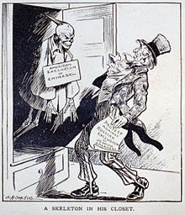
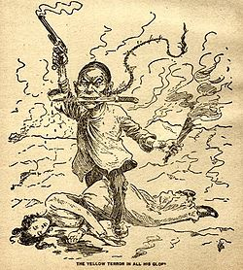
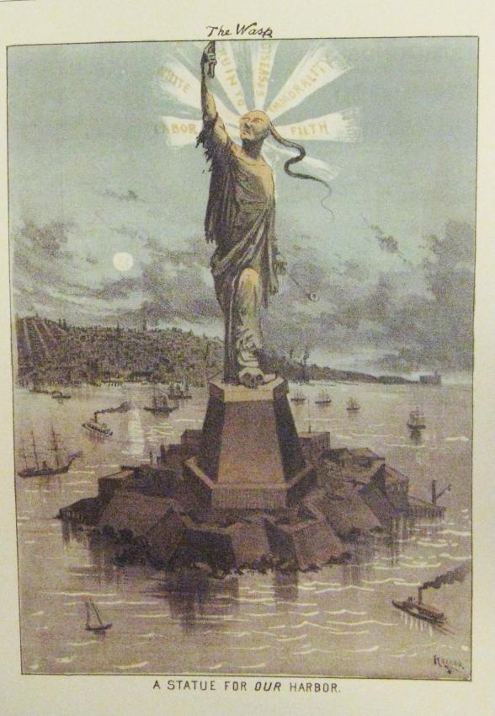
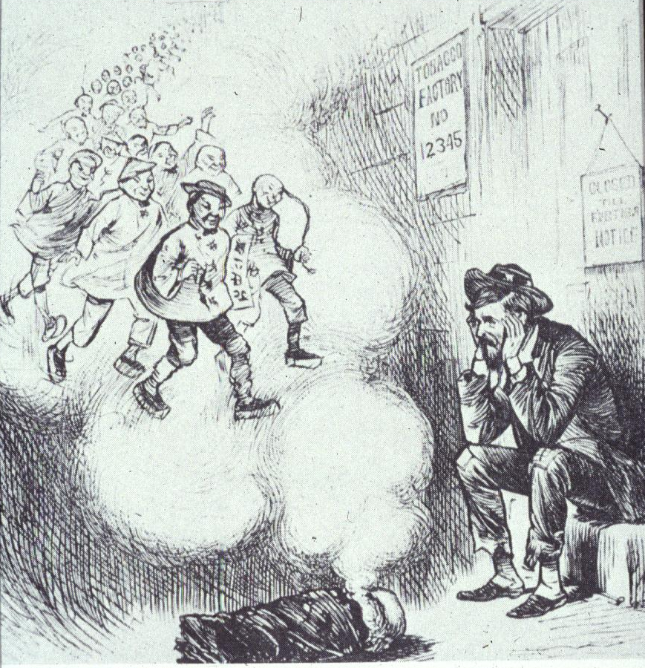

Slide 6
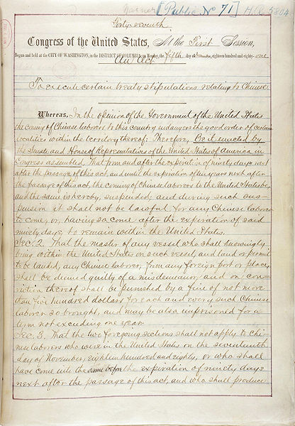
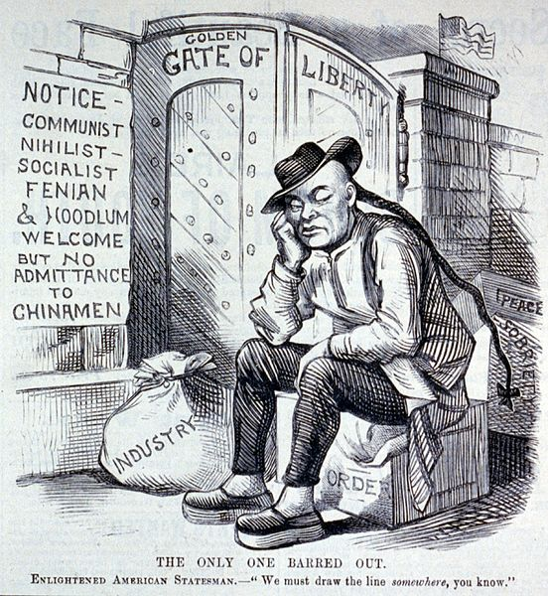
1882 Chinese Exclusion Act
1882 排华法案
“It shall not be lawful for any Chinese labor to come, or … to remain within the United States.”
“任何中国劳工来到美国或……留在美国都不合法。”

Slide 7
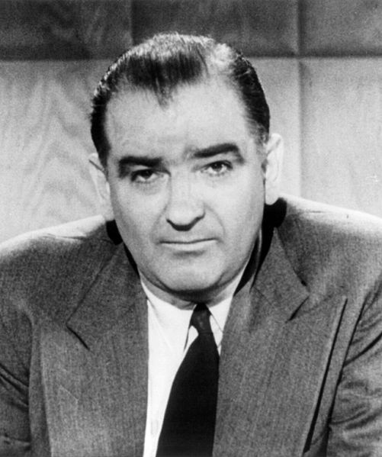
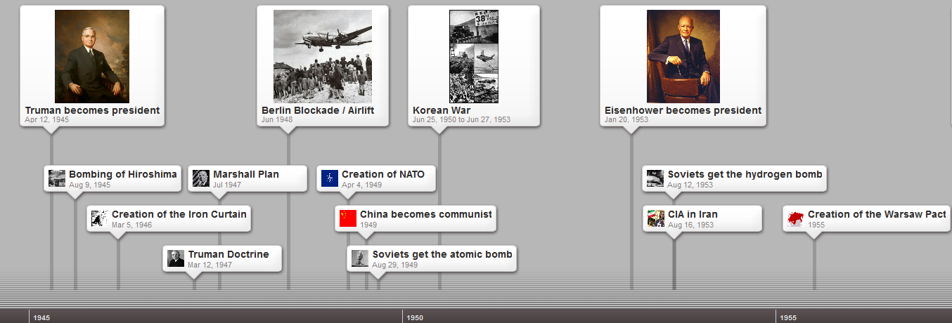
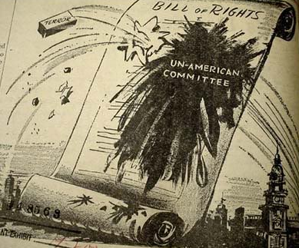
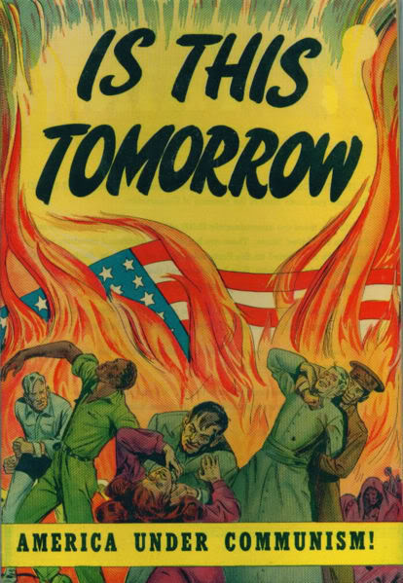

The Red Scare
红色恐怖
Senator Joseph McCarthy

Slide 8
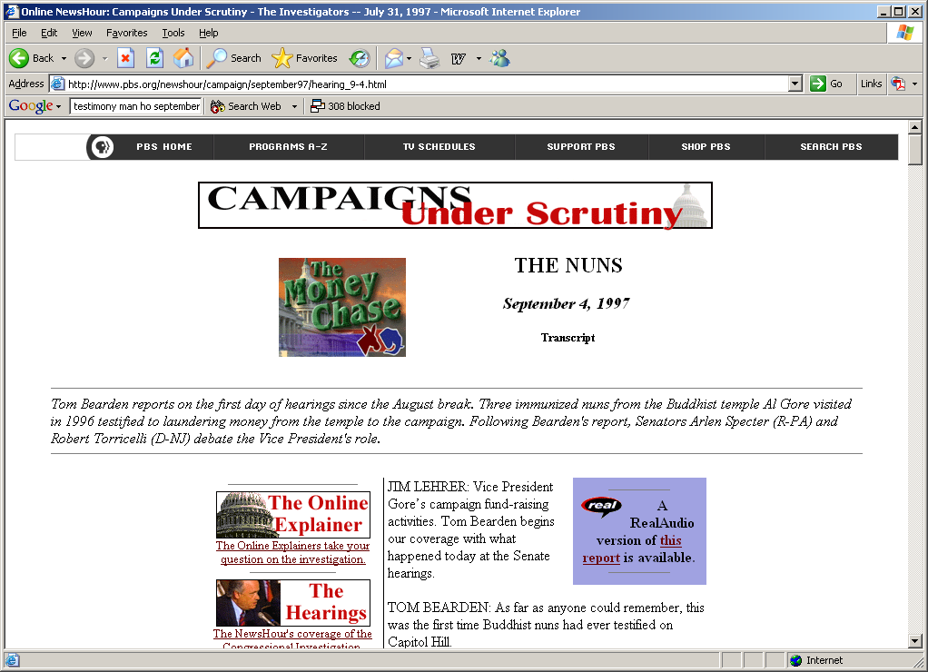
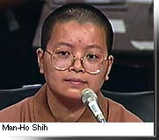
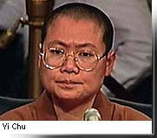
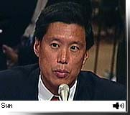
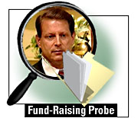
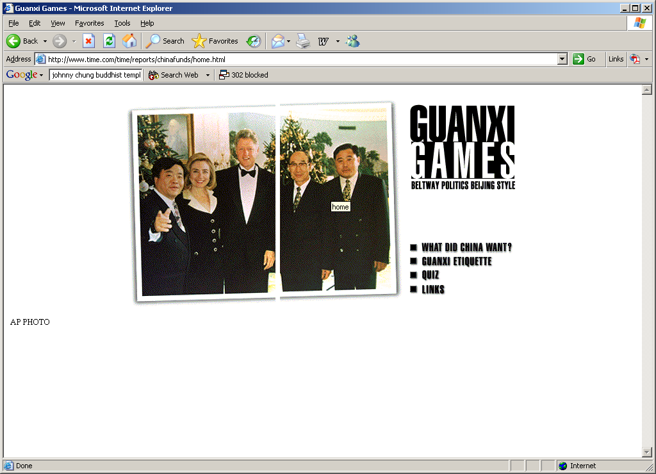
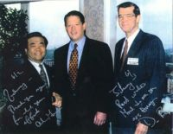
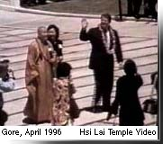
审查之下的竞选
金钱游戏
尼姑

Slide 9
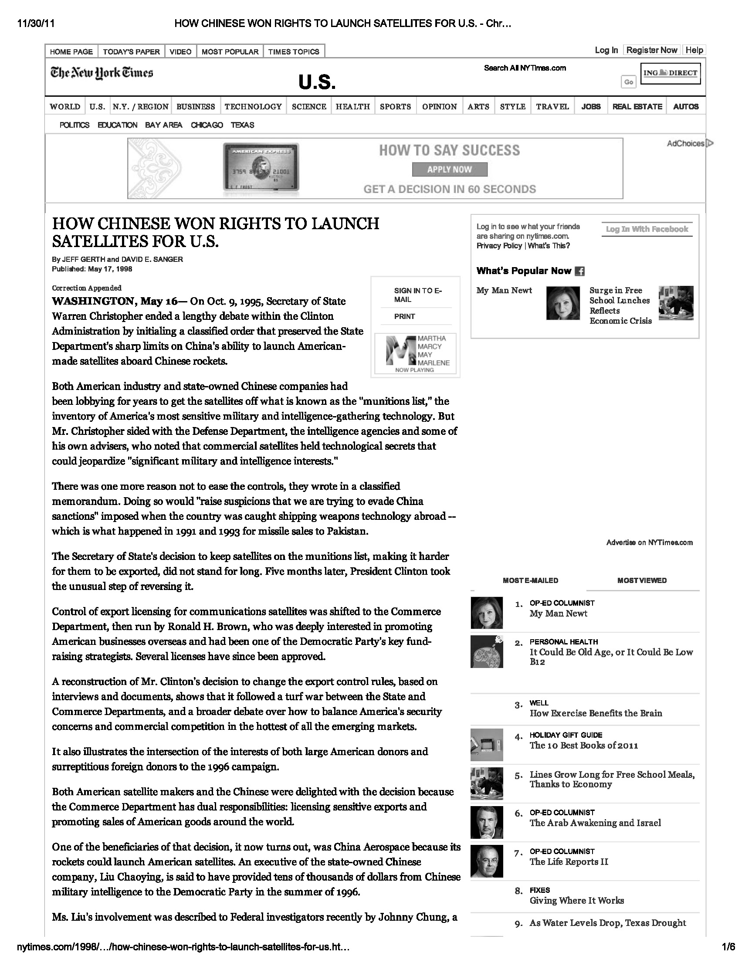
如何在最热门的新兴市场平衡美国的安全顾虑和商业竞争

Slide 10
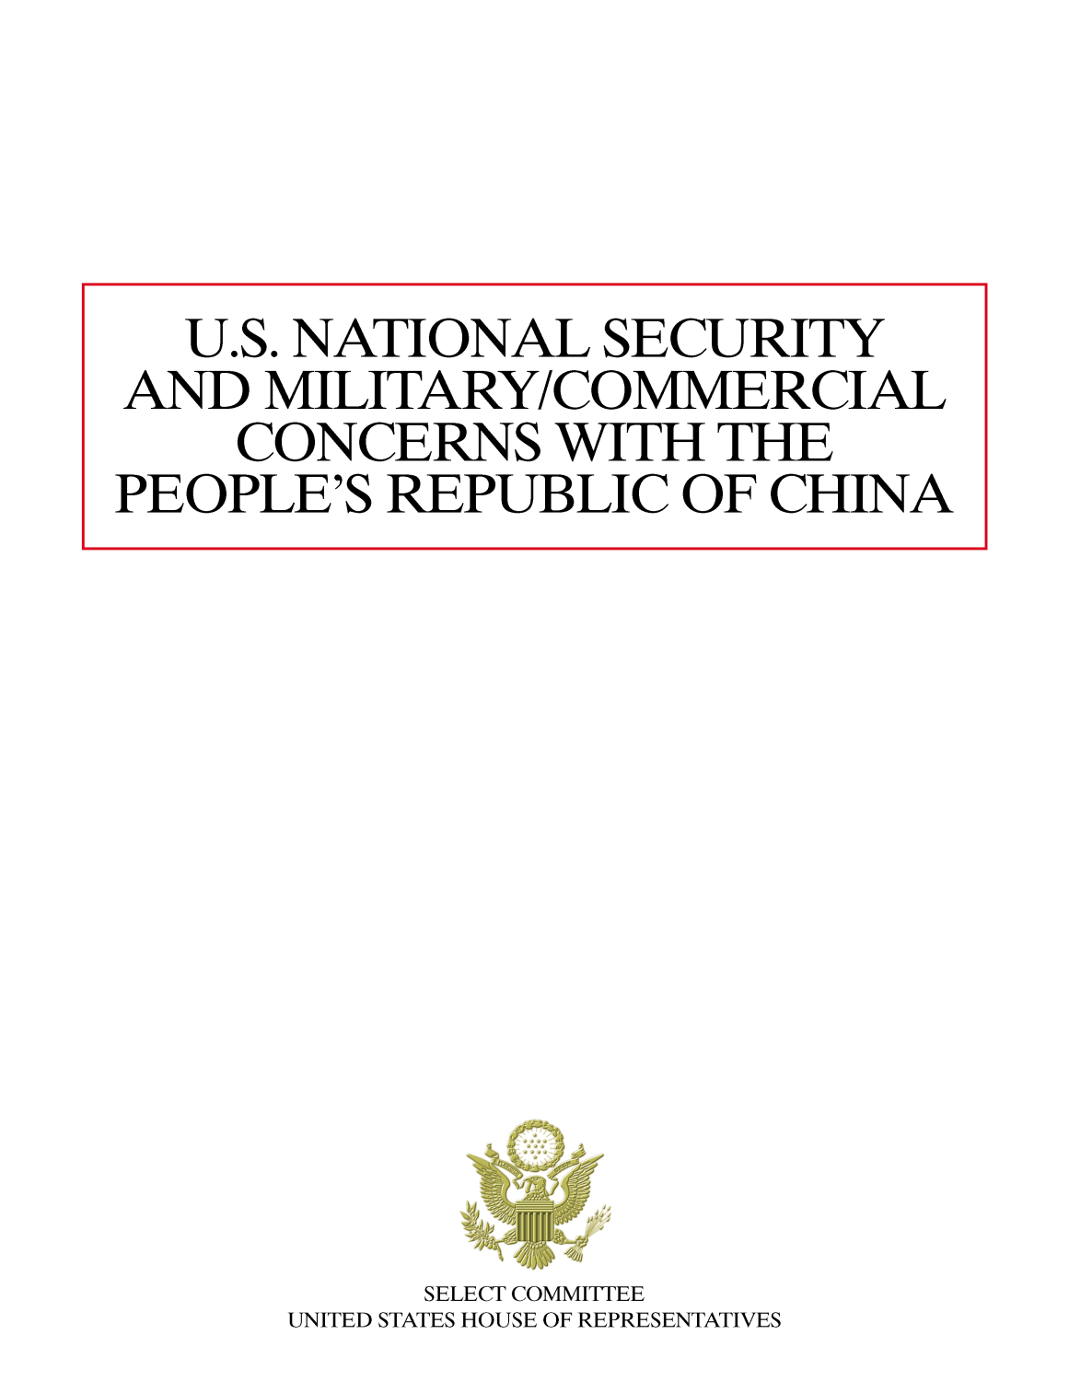
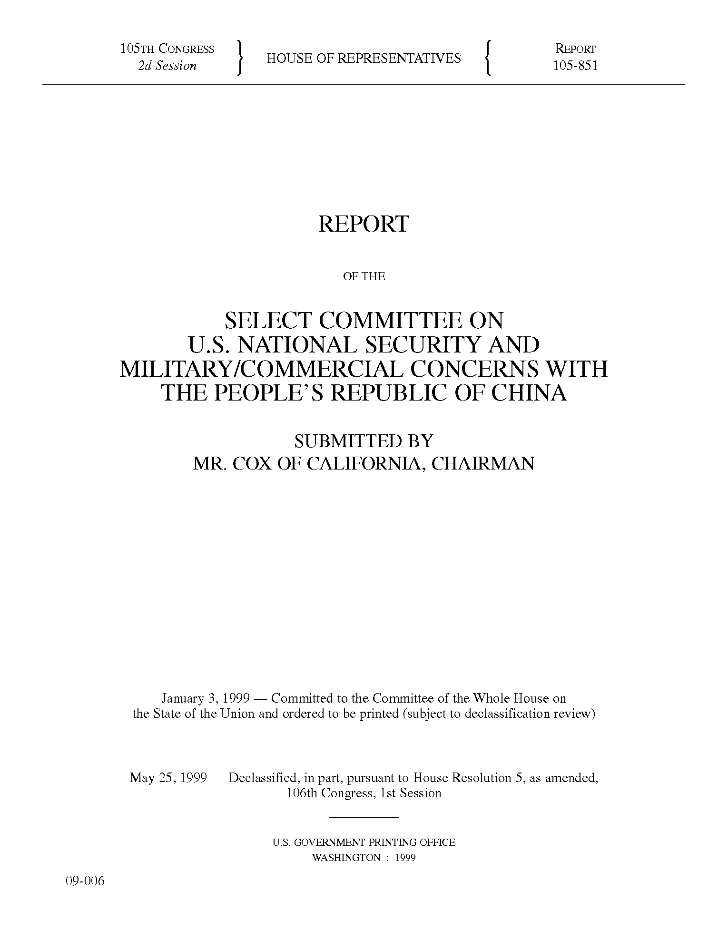
1999 Cox Report
1999 考克斯报告
委员会对于与中华人民共和国有关的美国国家安全和军事/商业关切

Slide 11

Dr. Wen Ho Lee, former physicist, Los Alamos National Laboratory, New Mexico
李文和博士，新墨西哥州
前洛斯阿拉莫斯国家实验室物理学家

Slide 12
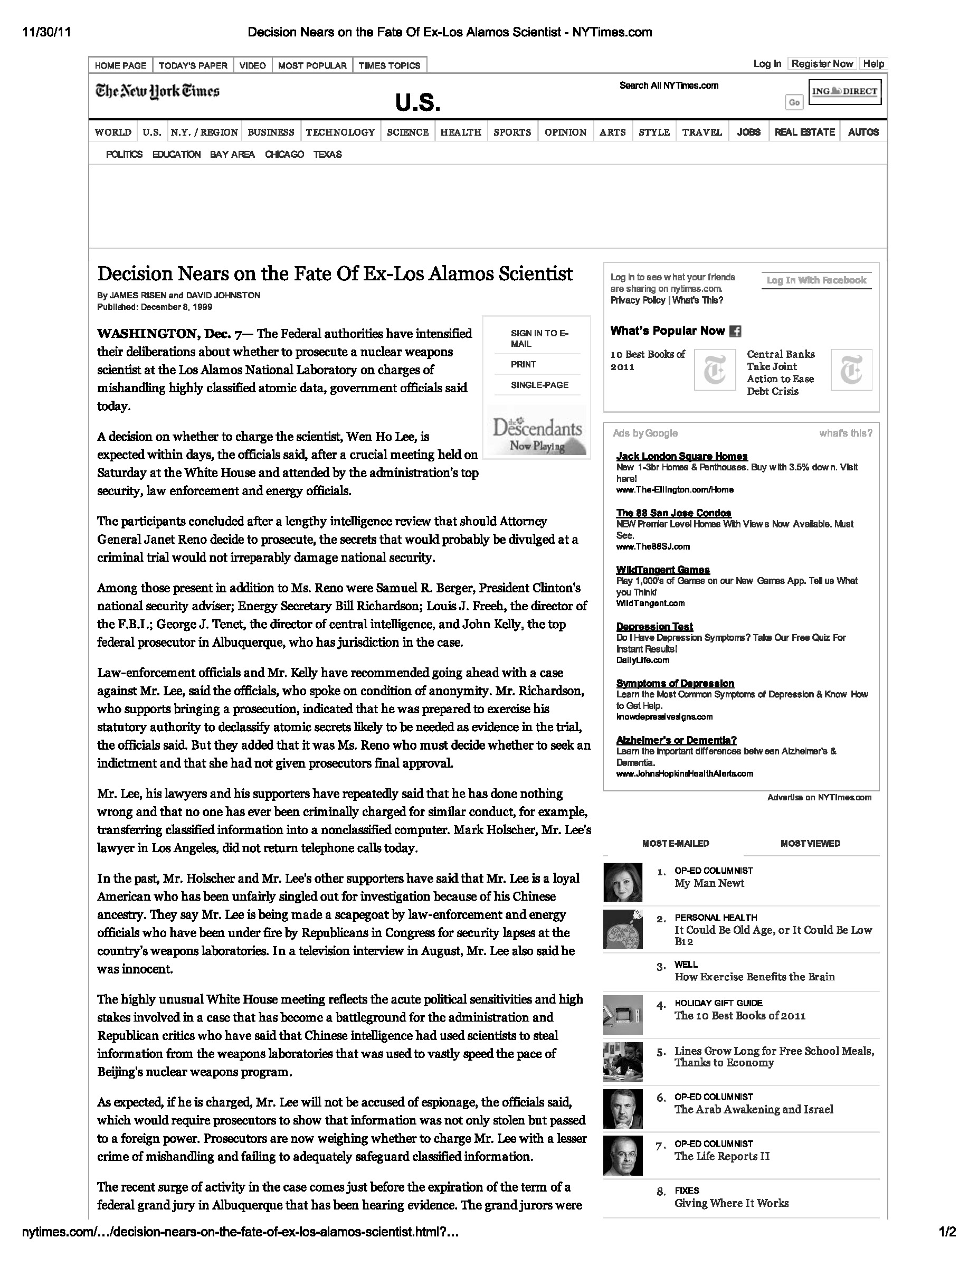
来自白宫和政府的压力

Slide 13
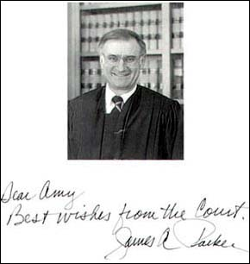
Judge Parker’s Apology
帕克法官的道歉

Slide 14
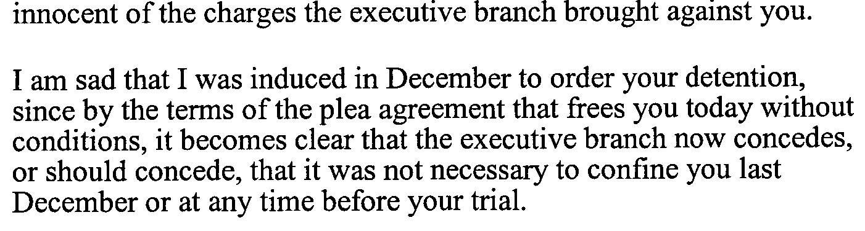
Judge Parker’s Apology
帕克法官的道歉

Slide 15
Judge Parker’s Apology
帕克法官的道歉
李博士，我非常难过地告诉你，我感觉去年12月我被我国政府的行政当局通过司法部、联邦调查局和当时的新墨西哥检察官带入歧途。
我很为你和你的家人难过，对于行政部门对你提出的指控，尽管法律证明你的清白无辜，你却以这种形式被关押。
我很难过因为我在12月受到诱导下令将你拘押，而在今天无条件释放你的认罪协议面前，我们明确看出行政部门现在承认，或者应该承认，去年12月或是在审判之前任何时候对你的拘押都毫无必要。

Slide 16
Judge Parker’s Apology
帕克法官的道歉
正是行政当局的高层决策者们，特别是司法部、能源部和地方的决策者们，造成了这一案件令人羞愧的开始和处理方式。他们不仅使我感到羞愧，也使整个国家和这个国家里的每个公民感到羞愧。
我也许要说，我的难过和苦恼是因为我不知道行政当局所有一切的真正原因。由于在认罪协议的庇护下，行政部门不必披露能够给我们答案的信息，我们将无法知道原因。

Slide 17
Judge Parker’s Apology
帕克法官的道歉
尽管如我所说，我无权代表行政当局、总统、副总统、司法部长、或能源部长发言，但作为美国政府第三权、作为司法部门、作为美国法院的一员，我为行政部门将您拘押的不公正处置向您，李博士，致以诚挚歉意。

Slide 18
Geopolitical Situation between the U.S. and China
美国和中国之间的地缘态势

Slide 19
Chinese Students and the U.S. Science and Technology Workforce
中国学生和美国的科技劳动力

Slide 20
The Chinese in America
华人在美国
As of 2010 census, approx. four million ethnic Chinese live in the U.S.
About 25% of all Asian Americans are ethnic Chinese
Chinese Americans heavily concentrated in 10 major states: CA, NY, HI, TX, NJ. MA, IL, WA, FL, PA
About 50% of Chinese Americans 1st generation immigrants from China or other Asian countries and 50% born in U.S.
Almost 40% of adult Chinese Americans have at least bachelor’s degree vs. about 22% for U.S. national average
根据2010年的人口调查，大约有400万华人在美国居住
约有25%的亚裔美国人是华人
美籍华人主要集中在10个州：加州、纽约州、夏威夷、德克萨斯州、新泽西州、马萨诸塞州、伊利诺伊州、华盛顿州、佛罗里达州、宾夕法尼亚州
约有50%的美籍华人是来自中国或其他亚洲国家的第一代移民，50%是在美国出生
有接近40%的成年美籍华人拥有学士以上学位，而全美的平均比例为22%

Slide 21
U.S. Colleges and Universities and
Foreign Students
美国高校和外国学生
Surging enrollment of Chinese students in U.S. colleges, universities:
  2010-11: 157,558 Chinese students (23.5% growth)
  2011-12: 194,029 Chinese students (23.1% growth)
  2012-13: 235,597 Chinese students (21.4% growth)
Chinese students currently almost 29% of all foreign students studying in United States (2012-13)
进入美国高校的中国学生数量迅速增长：
  2010-11年：157,558名中国学生 (增长23.5%)
  2011-12年：194,029名中国学生 (增长23.1%)
  2012-13年：235,597名中国学生 (增长21.4%)
中国学生约占在美外国学生总数的29% (2012-13年)

Slide 22
U.S. Colleges and Universities and
Foreign Students
美国高校和外国学生
  Chinese enrollment now almost evenly divided with 44% in graduate or professional schools, 40% undergraduate
  Chinese students now comprise about 20% of all U.S. engineering students, >11% of all computer/math students
Source: 2011, 2012, 2013 Open Doors Data, Institute of International Education
  中国学生目前几乎平均分布，44%就读研究生或专业学院，44%就读本科
  中国学生目前占美国所有工科学生的20%，和所有计算机/数学专业学生的11%以上
  资料来源：国际教育研究所2011年、2012年、2013年门户开放数据

Slide 23
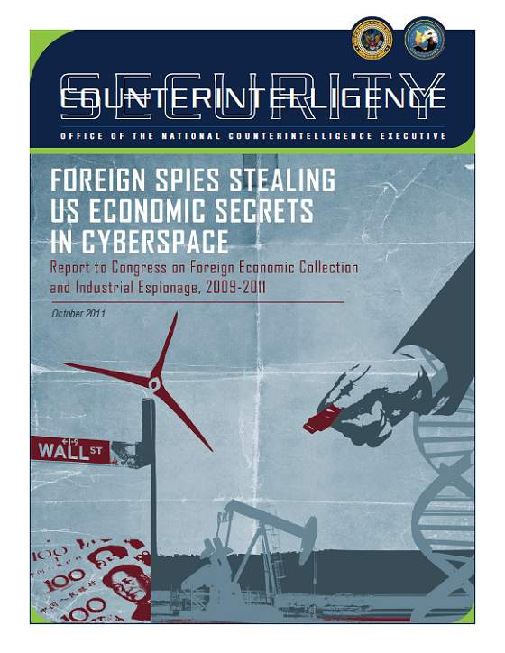
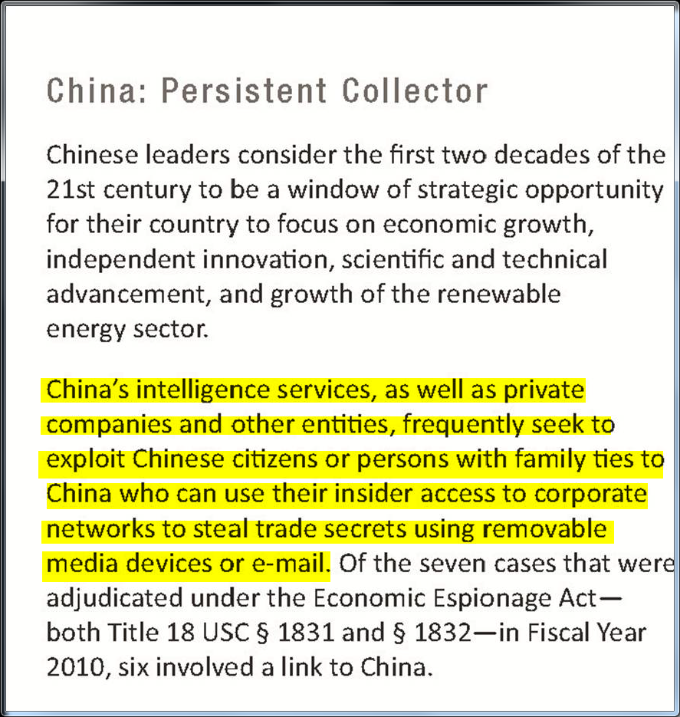
美国指责中国通过网络进行商业间谍活动

Slide 24
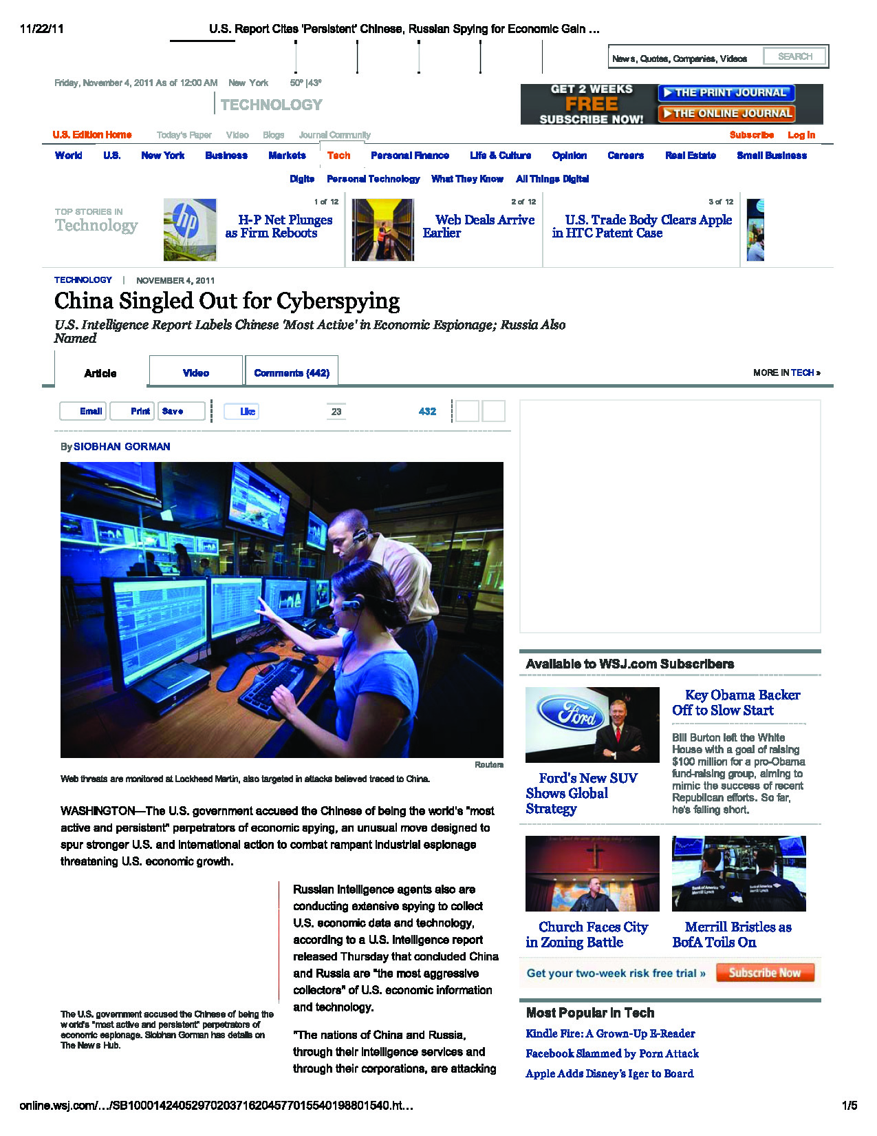
美国指责中国通过网络进行商业间谍活动

Slide 25
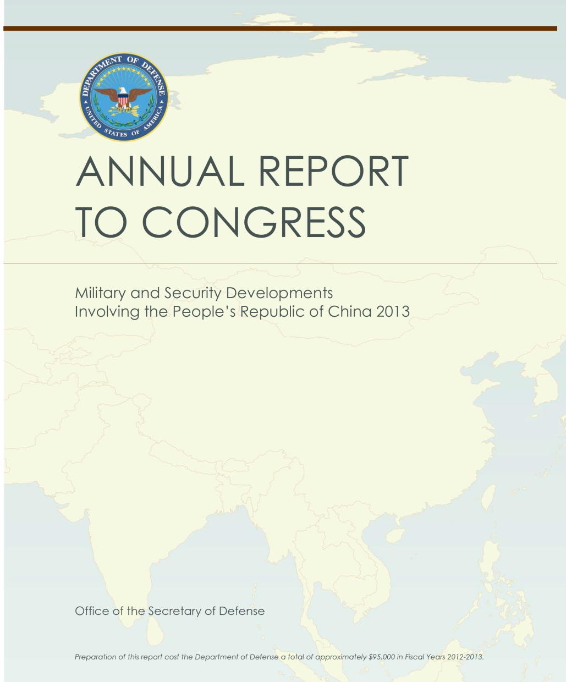
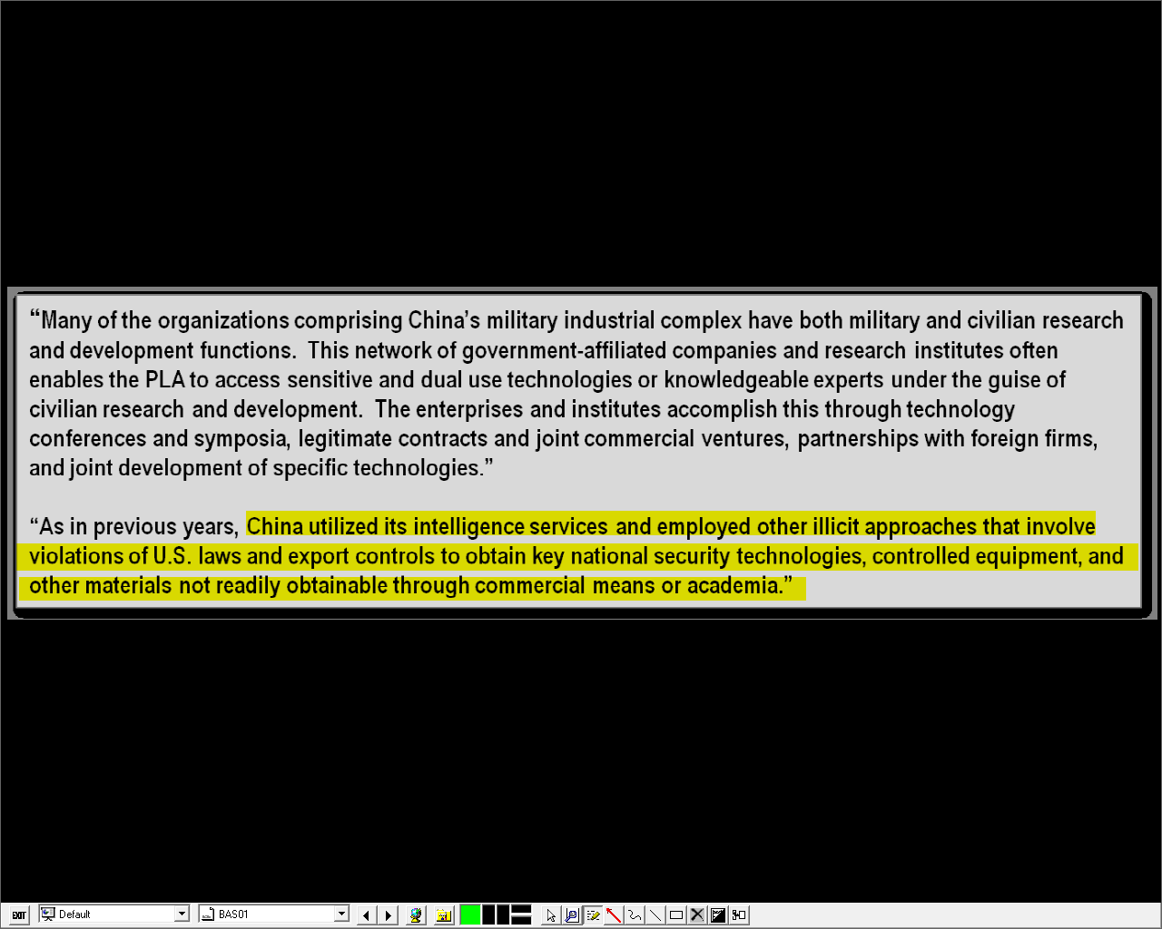
美国指责中国窃取重要的安全技术、特定设备、及其他未公开资料等

Slide 26
Current Legal Environment
当前法律环境

Slide 27
Espionage Defined
间谍定义
Merriam-Webster dictionary definition of “espionage”: “the practice of spying or using spies to obtain information about the plans and activities especially of a foreign government or a competing company”
As definition suggests, espionage can occur in two “forms”: “public” aimed at government secrets and “economic” or “industrial” aimed at business secrets
  Term “espionage” often loosely used without distinction between two forms
Today BOTH forms of espionage are illegal under U.S. laws, each with heavy penalties
  Separate criminal statutes for each form
  Different legal consequences for violations
韦氏字典的定义：“从事间谍活动或使用间谍手段获取有关计划或活动，信息，特别是针对外国政府或竞争企业”
该定义显示，间谍可以出现两个“形式”：“公共的”，针对政府机密；和“经济的”或“产业的”，针对商业秘密。
  术语“间谍”经常不加区分的泛指这两个形式
如今这两种形式在美国法律下都是会施以重罚的违法活动
  每种形式有不同的刑事法规
  有不同的违法后果

Slide 28
A Complex Legal System
复杂的法律体系
United States: probably most complex, costly legal environment in the world
  Criminal prosecutions (by government)
  Administrative proceedings (by government)
  Civil litigation (by either government or private parties)
  Defense costs, reputational damage
  Severe disruption of normal work, business relationships
  Possible effects upon U.S. immigration, naturalization status
美国可能有全世界最复杂最昂贵的法律环境
  刑事检控（政府）
  行政诉讼（政府）
  民事诉讼（政府或私人）
  应诉费用，声誉受损
  严重扰乱正常的工作和业务关系
  可能对美国移民和归化造成影响

Slide 29
A Complex Legal System
复杂的法律体系
U.S. Government’s civil and criminal enforcement tools:
  Government espionage laws
  Economic espionage laws
  Export control laws
  Computer crime laws
美国政府的民事和刑事执法工具：
  政府间谍法
  经济间谍法
  出口管制法
  计算机犯罪法

Slide 30
Government Espionage Laws
政府间谍法
Several different, somewhat overlapping statutes that date back to Espionage Act of 1917 and have been amended multiple times in past century
18 USC § 793: gathering, transmitting or losing defense information “to be used to the injury of the United States, or to the advantage of any foreign nation”
18 USC § 794: gathering or delivering defense information “to be used to the injury of the United States, or to the advantage of any foreign nation”
18 USC § 798: disclosure of classified cryptography information “prejudicial to the safety or interest of the United States or for benefit of any foreign government to the detriment of the United States”
数个不同但又重叠的法条可以追溯到1917年间谍法案的，并在过去一个世纪中多次修订
18 USC § 793: 收集、传输或丢失国防信息“用以伤害美国或给予任何外国以优势”
18 USC § 794: 收集或递送国防信息“用以伤害美国或给予任何外国以优势”
18 USC § 798: 披露机密信息“有损于美国安全与利益或使任何外国受益以损害美国”

Slide 31
Government Espionage Laws
政府间谍法
Since 1996, federal crimes to steal trade secrets:
  18 USC § 1831: Economic espionage for benefit of a foreign government; or
  18 U.S.C. § 1832: Economic espionage for benefit of anyone other than its lawful owner
Reflects recognition of corporate value in intellectual assets and focus on international IP enforcement
New law added public (criminal) protection to private (civil) right in intellectual property (IP), trade secrets
§ 1831 criminal penalties: up to 15 years in prison and/or $5,000,000 fine for individuals and higher of $10,000,000 or 3X value of IP for corporations
§ 1832 criminal penalties: up to 10 years in prison and/or $250,000 fine for individuals or $5,000,000 for corporations
自1996年来，窃取商业机密联邦罪：
  18 USC § 1831: 经济间谍以使外国政府受益，或者
  18 U.S.C. § 1832: 经济间谍以使其合法拥有者以外的任何人受益
反映出对于知识资产商业价值的认可和注重国际知识产权执法
新法律增加了对于私人（民事）知识产权和商业秘密的公共（刑事）保护
§ 1831 刑事处罚: 对个人最高15年的监禁和/或5百万美元罚款，对企业最高1千万美元或3倍于知识产权价值的罚款
§ 1832 刑事处罚: 对个人最高10年监禁和/或25万美元罚款，对企业最高5百万美元罚款

Slide 32
What Is a “Trade Secret”?
什么是“商业秘密”？
Generally speaking, any kind of information that:
  Has independent economic value,
  Is not generally known to the public or others who can obtain economic value from its disclosure or use, and
  Is kept secret through reasonable means
Examples include proprietary drawings, software, blueprints, formulae, specifications, customer or supplier lists, test data, prototypes, etc.
Trade secret can be found in any form or media: written, electronic, oral or even in human memory
Often but not always marked as such in documents
Often implied by security measures taken: nondisclosure agreements (NDAs), badges, passwords, limited distribution, access controls, physical security, etc.
通常而言，任何信息：
  有独立的经济价值
  不为公众或可以通过它的披露获取经济利益的人所广泛知晓
  通过合理的手段保密
例子包括专利图纸、软件、图纸、配方、规格、客户或供应商名单、测试数据、样机等
商业秘密可存在于任何媒介：书面、电子、口头、甚至人类记忆
常常但不总是标记为机密的文件
通过安保措施显示出的：保密协议、徽章、密码、限量发行、访问控制、物理安全等

Slide 33
U.S. Export Control Laws
美国出口管制法
Trade embargoes (e.g., Cuba, Iran) administered by the U.S. Treasury Department’s Office of Foreign Assets Control (OFAC)
Export Administration Regulations (EAR) administered by the U.S. Commerce Department’s Bureau of Industry and Security (BIS)
  Controls exports of “dual use” technologies
  Many items exportable to China only under BIS license
International Traffic in Arms Regulations (ITAR) administered by the U.S. State Department’s Directorate of Defense Trade Controls (DDTC)
  Controls exports of “military” technologies
  “Policy of denial” = total arms embargo against China
贸易禁运（如古巴、伊朗）由美国财政部外国资产控制办公室（OFAC）管理
出口管理条例（EAR）由美国商务部的工业和安全局（BIS）管理
  控制“军民两用”技术出口
  许多项目只能通过BIS许可出口到中国
国际武器贸易条例（ITAR）由美国国务院国防贸易管制事务局（DDTC）管理
  控制“军事”技术出口
  “否定政策”=对中国全面的武器禁运

Slide 34
U.S. Export Control Penalties
美国出口管制处罚
Most OFAC embargoes and current EAR apply penalties under International Emergency Economic Powers Act (IEEPA)
  Civil fine: up to greater of US$250,000 or 2X transaction value (strict liability regime)
  Criminal fine: up to US$1,000,000; up to 20 years in federal prison; or both
ITAR apply penalties under Arms Export Control Act (AECA)
  Civil fine: up to greater of US$500,000 or 5X transaction value
  Criminal fine: up to US$1,000,000; up to 20 years in federal prison per violation; or both
大多数OFAC禁运和当前EAR适用《国际紧急经济权力法》（IEEPA）的处罚
  民事罚款：最高超过25万美元或2倍交易价值（严格责任制度）
  刑事罚款：最高1百万美元；最高20年监禁；或两者兼有
ITAR适用《武器出口控制法》（AECA）的处罚
  民事处罚：最高超过50万美元或5倍交易价值
  刑事处罚：最高1百万美元；每项违法最高20年监禁; 或两者兼有

Slide 35
U.S. Computer Crime Laws
  美国计算机犯罪法
18 USC. §1030: Computer Fraud and Abuse Act (“CFAA”)
CFAA intended to reach all forms of computer crime:
  (a)(1): illicit access to computer to commit espionage
  (a)(2): computer trespass to access government, financial, credit or commercial information
  (a)(3): computer trespass to access government computer
  (a)(4): fraud through computer trespass to access government, financial, credit or commercial computer
  (a)(5): damaging government, financial, credit or commercial computer
  (a)(6): trafficking in stolen computer passwords
  (a)(7): threatening to damage government, financial, credit or commercial computer
  18 USC. §1030: 《计算机欺诈和滥用法》 (CFAA)
CFAA旨在涵盖各种形式的计算机犯罪：
  (a)(1): 非法访问计算机以从事间谍活动
  (a)(2): 计算机非法侵入访问政府、金融、信贷或商业信息
  (a)(3): 计算机侵入访问政府计算机
  (a)(4): 通过计算机造假非法侵入访问政府、金融、信贷或商用计算机
  (a)(5): 破坏政府、金融、信贷或商用计算机
  (a)(6): 贩卖盗取的计算机密码
  (a)(7): 威胁破坏政府、金融、信贷或商用计算机

Slide 36
U.S. Computer Crime Penalties
  美国计算机犯罪处罚
Criminal penalties include:
  Fines of up to higher of $100,000 for misdemeanor or $250,000 for felony or twice value of loss to victim
  Imprisonment for up to one year for misdemeanor or up to 20 years for felony
  Or both fine and imprisonment
Original law amended in 1992 to provide separate right for victim to sue offender privately in a civil action
  To bring a private civil CFAA action, victim of crime must allege, prove loss of at least $5,000
  “Loss” means “any reasonable cost to any victim, including the cost of responding to an offense, conducting a damage assessment, and restoring the data, program, system, or information to its condition prior to the offense, and any revenue lost, cost incurred, or other consequential damages incurred because of interruption of service.”
刑事处罚包括：
  轻罪：最高超过10万美元罚款；重罪：25万美元罚款或两倍于受害人损失
  轻罪：最高1年监禁；重罪：最高20年监禁
  或同时罚款和监禁
原法于1992年修订，为受害人提供单独私人民事起诉的权利
  为提起私人民事CFAA诉讼，犯罪的受害人必须声称、证明至少5千美元的损失
  “损失”是指“任何受害人合理的任何费用，包括应对攻击、进行破坏评估、恢复数据、程序、系统或者信息至损坏之前的条件等费用，并包括任何收入损失、产生的费用、或因服务中断造成的其他间接损失。

Slide 37
Recent Federal Prosecutions
近期的美国联邦检控

Slide 38
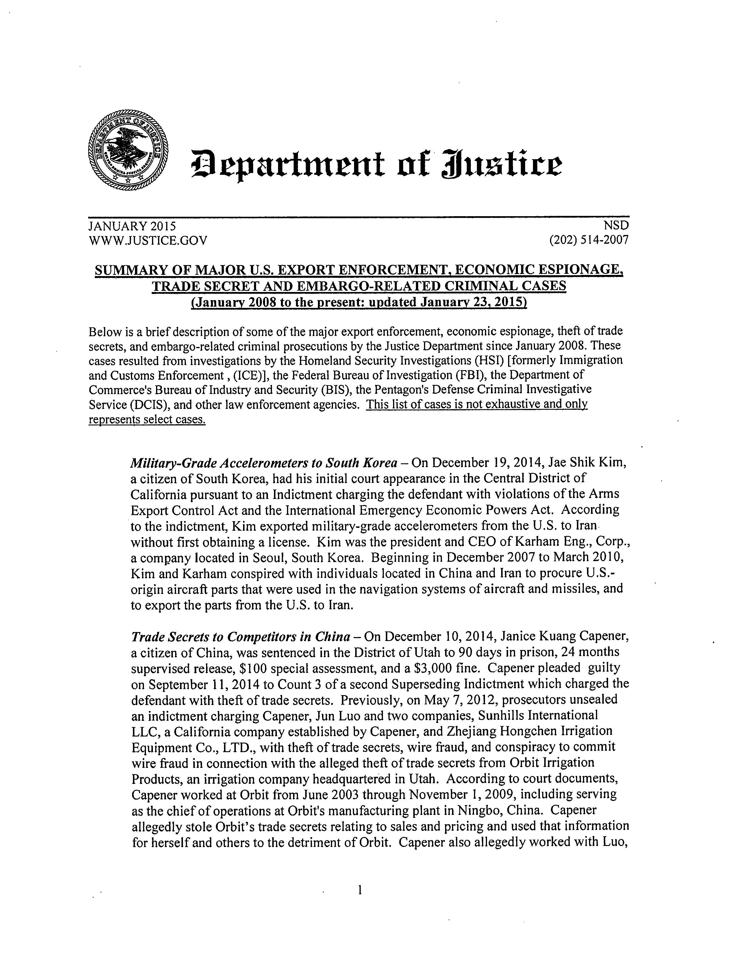
美国主要的出口执法、经济间谍、商业秘密和与禁运有关的犯罪案件汇总
(2008年1月至今：2015年1月23日更新)

Slide 39
















Some Affected U.S. Companies
受影响的部分美国公司

Slide 40
2012 Export Control Case
2012出口管制案例
Jian (“Jason”) Liang pled guilty to illegal export of 63 L-3 thermal imaging cameras to China without required Commerce Department EAR export licenses
  Case filed in Central District of California
Liang made total of seven shipments of cameras to China over 31-month period
L-3 had advised Liang of applicable U.S. export controls on its cameras
Liang’s sentence: 46 months in prison; 36 months additional supervised probation after release
梁健（音译）因未获得必须的商务部EAR出口许可证而非法向中国出口63 L-3热成像摄像机被判有罪
  案件归档于加利福尼亚中央区
梁健在31个月内共七次向中国发货
L-3曾告知梁健其相机适用的美国出口管制
梁健的判决：46个月监狱服刑；释放后36个月额外缓刑监督

Slide 41
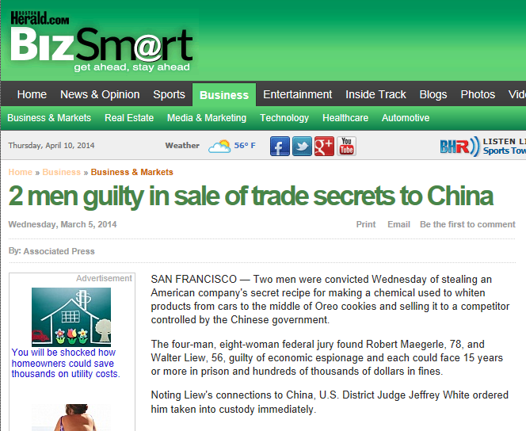
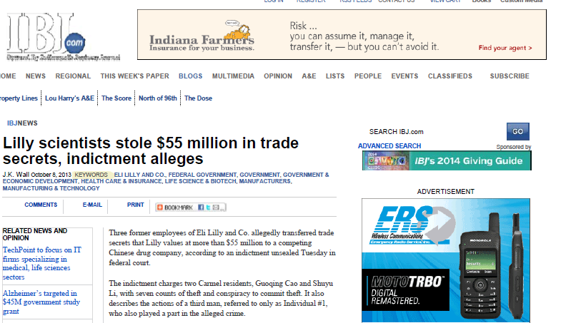
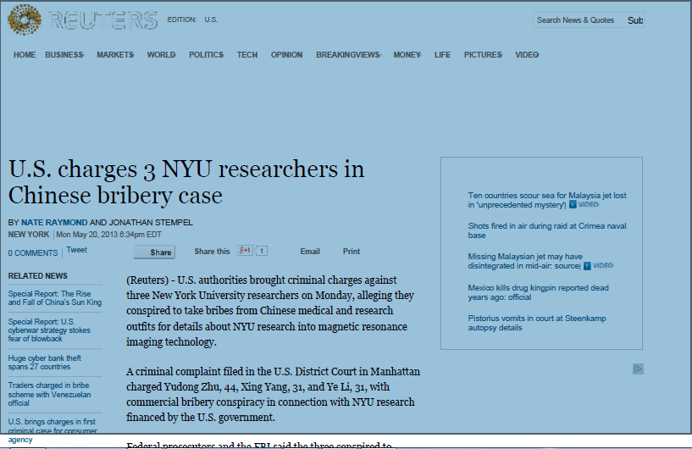
起诉书称礼来公司(Eli Lilly)科学家窃取5千5百万美元的商业秘密
美国就中国贿赂案对3名纽约大学研究员提出指控

Slide 42
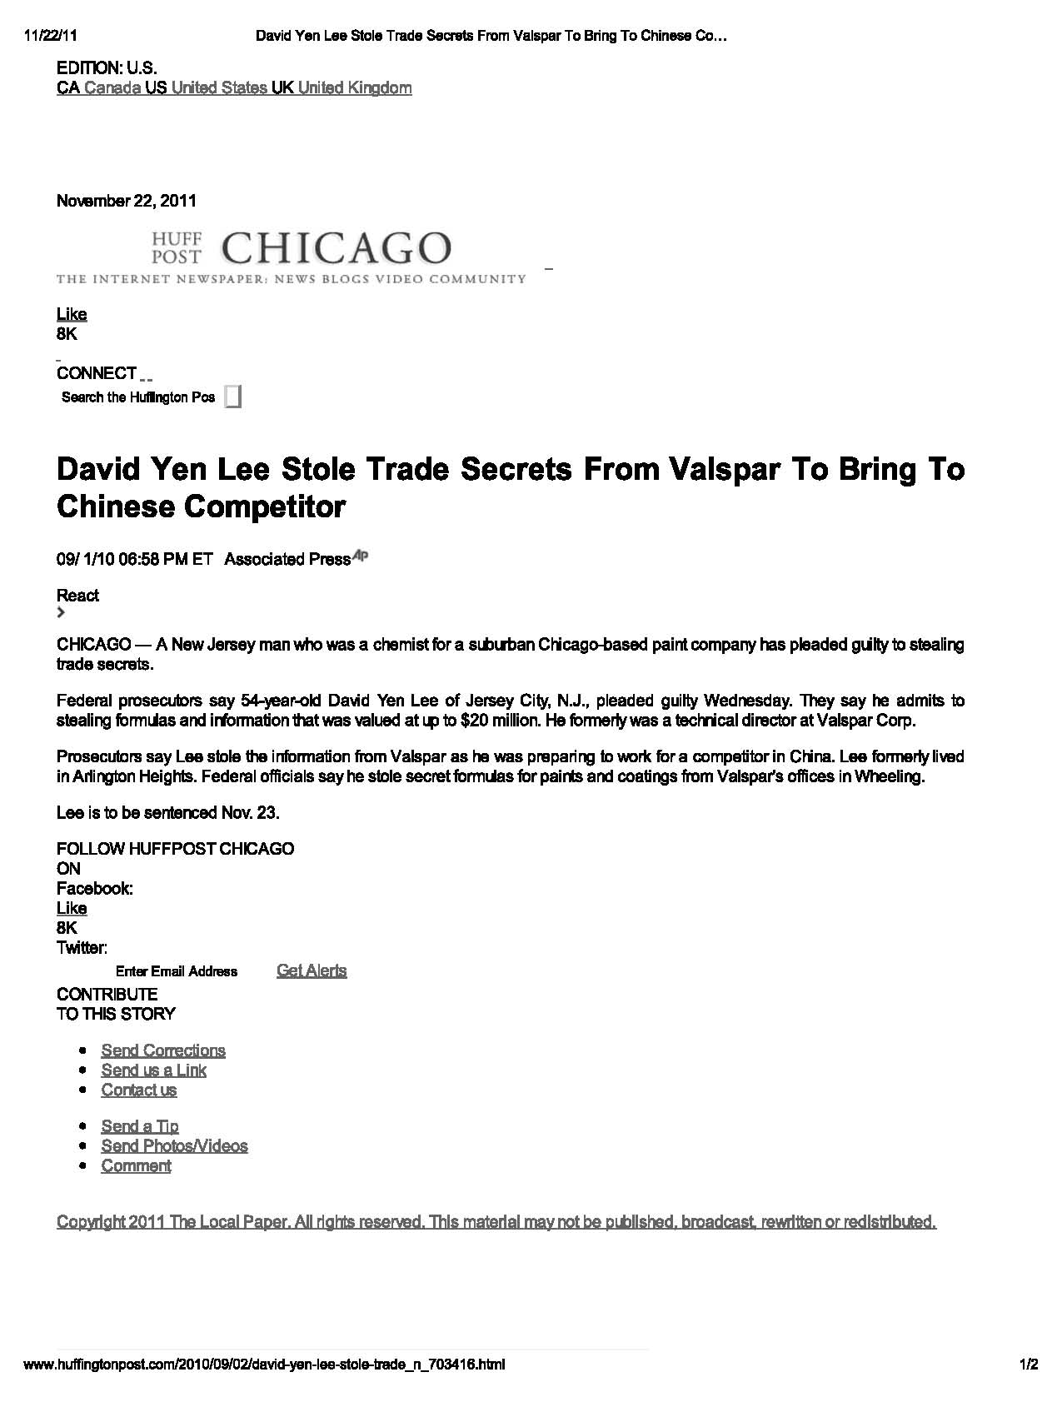
Criminal Prosecutions
刑事检控
David Yen Lee 从威士伯(Valspar)窃取商业秘密交给中国的竞争对手

Slide 43
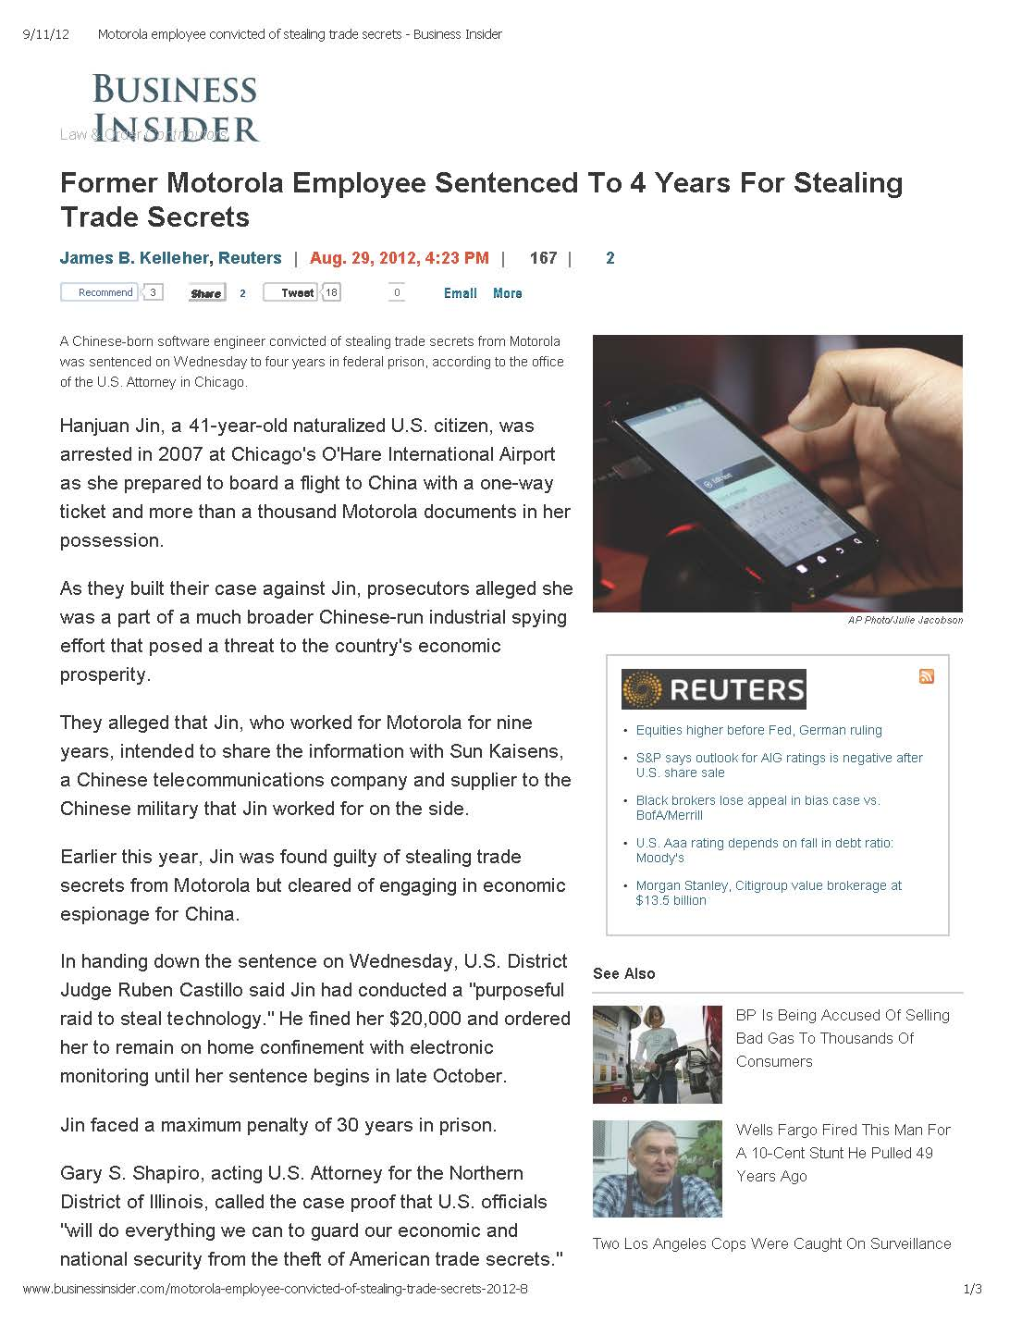
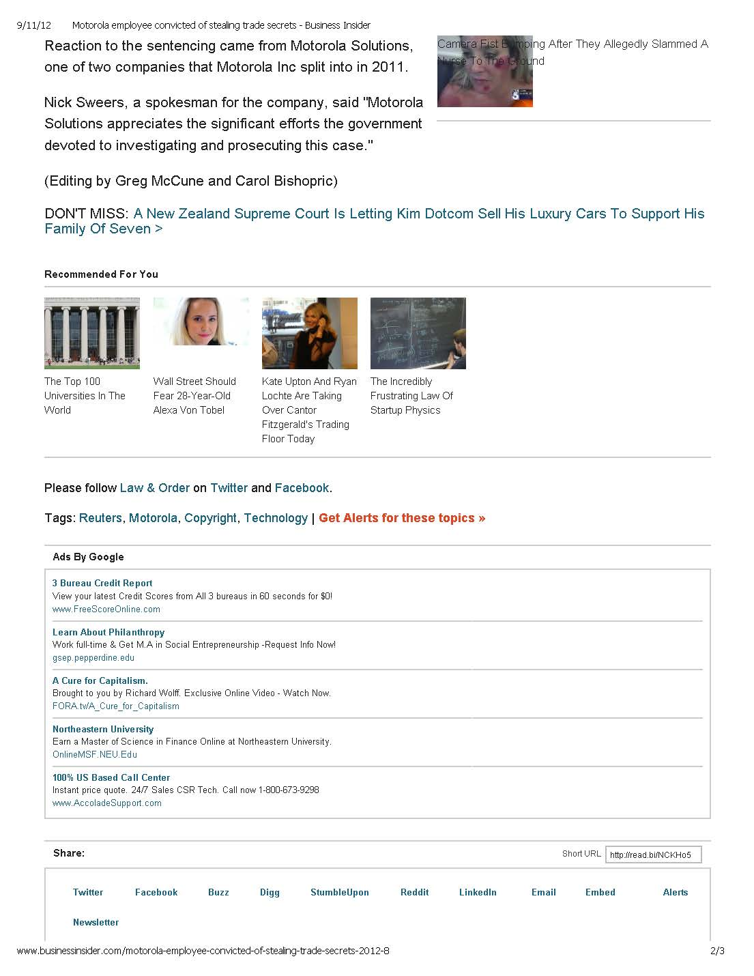
Criminal Prosecutions
刑事检控
前摩托罗拉员工因窃取商业秘密被判4年
金涵娟, 41岁的归化美国公民，2007年购买单程机票携带上千份摩托罗拉资料回中国的途中在芝加哥国际机场被捕
金面临高达30年监禁

Slide 44
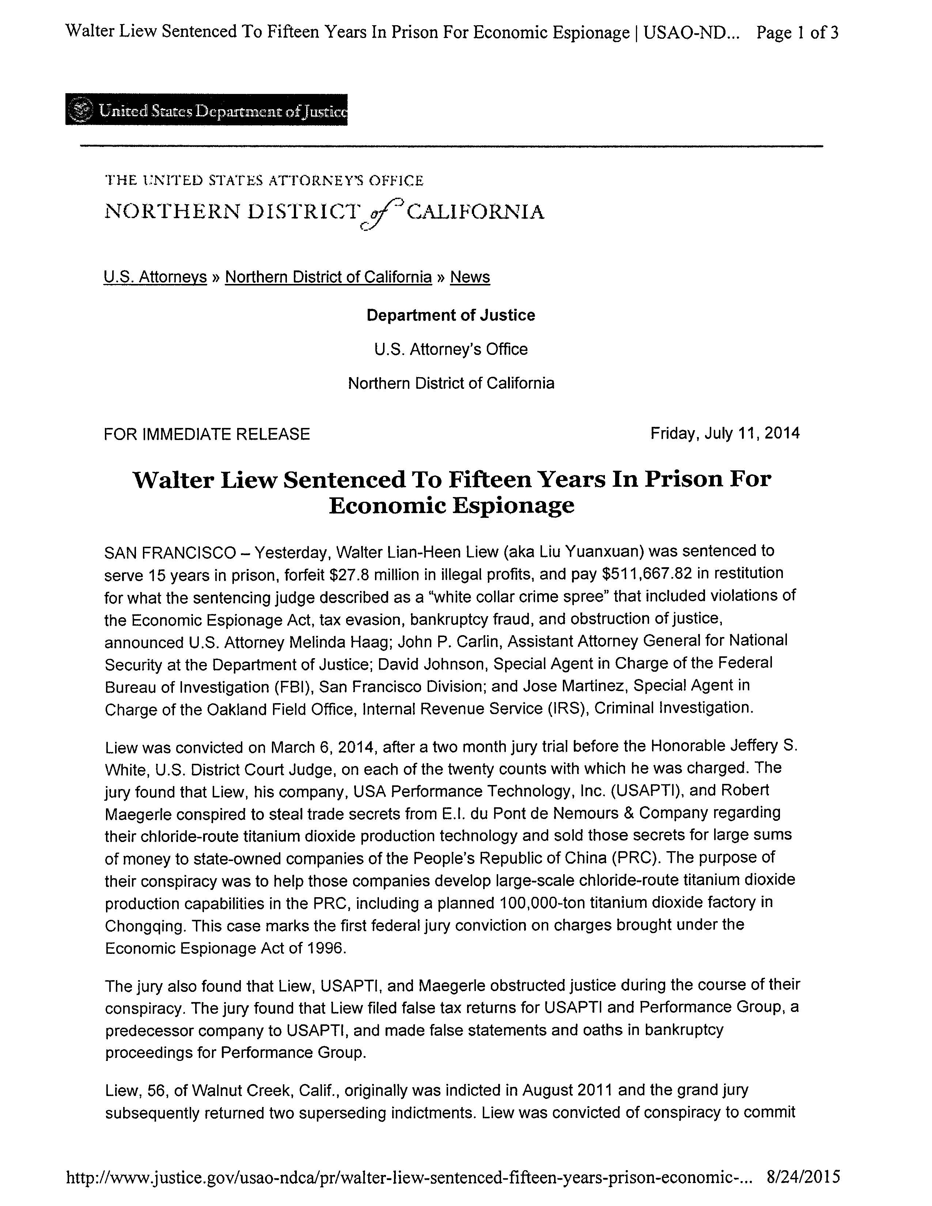
刘元轩（Walter Liew）被判15年

Slide 45
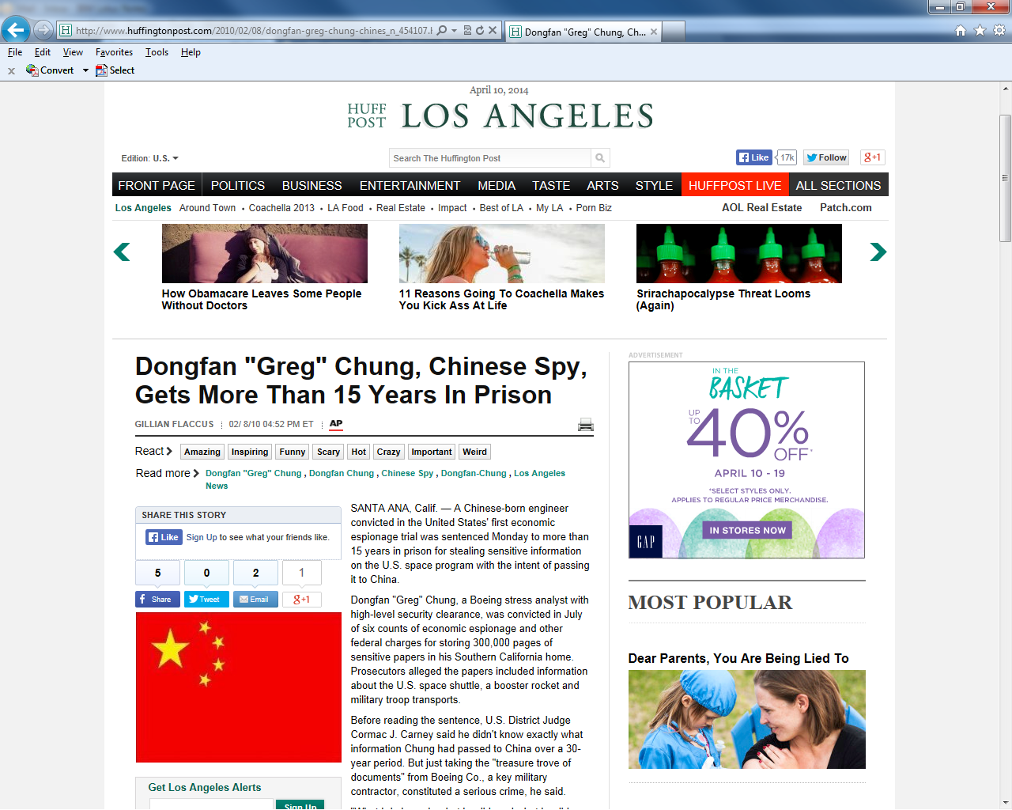
中国间谍钟东蕃被判超过15年监禁
一位中国出生的工程师在美国第一个经济间谍案中，因盗窃美国太空计划敏感信息并意图传递至中国被判入狱15年以上

Slide 46
2010 Economic Espionage Act Conviction
2010经济间谍法定罪
Dongfan "Greg" Chung, Chinese-born engineer and former Boeing stress analyst possessing high level security clearances, convicted of economic espionage and other charges, for storing allegedly sensitive papers in his home taken from Boeing with the intent to pass it on to China
The papers in Chung's possession included information related to the space shuttle, booster rockets and military troop transports
Chung has asserted that he took the information to write books and had no intent to harm national security; no specific evidence was presented what Chung may have sent to China or who received it or how much it "hurt" the United States
Chung, 74 years old at the time of his sentencing, received a fifteen year jail sentence and has lost his appeals.
钟东蕃 ，中国出生的工程师，前波音应力分析师，拥有高级安全级别，被定罪为经济间谍和其他罪名，因其家中存储了由波音公司获得的据称为敏感的资料，并意图传递到中国
钟所持有的资料包括与航天飞机、助推火箭和军用运兵船有关的信息
钟曾声称其因著书需要带走这些信息，并无意图危害国家安全；（检方）没有提出具体的证据证明钟可能递送到中国何种信息或何人收到信息，或对美国有多大的“伤害”
钟在74岁高龄时遭判决15年监禁，并且上诉失败

Slide 47
2013 “National Security” Case
2013 “国家安全”案
Bo Jiang had obtained Ph.D. from Old Dominion University in 2010 and worked as researcher at National Institute of Aerospace (NIA), a research consortium of several southern universities
After being named by a local Congressman as a potential national security risk, Dr. Jiang was terminated by NIA in December 2012 and, with no further work opportunities in United States, had purchased one-way ticket home to China in March 2013
Federal agents arrested him at airport and took him off plane with his laptop computers and digital media
  Original federal indictment was about Dr. Jiang lying about what he was carrying out of country
Federal prosecutors then conceded in court he was carrying no classified information, export controlled information or proprietary information – only pornography – on his laptop
In plea bargain, Jiang pled guilty to misuse of NASA equipment in exchange for dismissal of indictment, so Jiang allowed to leave U.S. within 48 hours
江波，2010年于欧道明大学获得博士学位，在航空航天研究所（NIA）一个由几所南方高校组成的研究团队担任研究员
在被当地一位国会议员指为潜在国家安全风险后，江波博士于2012年12月遭NIA解雇，并在美国没有其他工作机会，2013年3月购买单程机票回中国
联邦特工在机场将其逮捕,并将其笔记本电脑和数码媒体带下飞机
  原联邦起诉书是关于江波博士对其所携物件出境说谎
联邦检察官之后在法庭承认江波未携带保密信息、出口控制信息或专有信息，而仅在其笔记本电脑中发现色情内容
在辩诉交易中，江对于滥用美国航空航天局设备认罪以换取撤诉。后来江获准在48小时内离开美国

Slide 48
Rare legal suit that won against the U.S. gov’t
Haiping Su held M.S. (1988) and Ph.D. (1991) from Kansas State University in agricultural science; U.S. citizen
Worked in tracking and reducing forest fires
Employed April 2005 – June 2008 at NASA Ames Research Center as analyst for University Affiliated Research Center operated by UC Santa Cruz
  NASA Ames Research Center is “badged” facility and only persons with such official badges may have access
  Research did not involve any national security or classified data
Subjected to intensive FBI interrogation, polygraph exam in early 2008; lost his badge and access rights to Center
UCSC refused to fire him and Su continued working at home
He sued U.S. Government and various officials at NASA & FBI in 6/09 and judge ruled in his favor on one count & award of $10K on 9/29/14

Slide 49
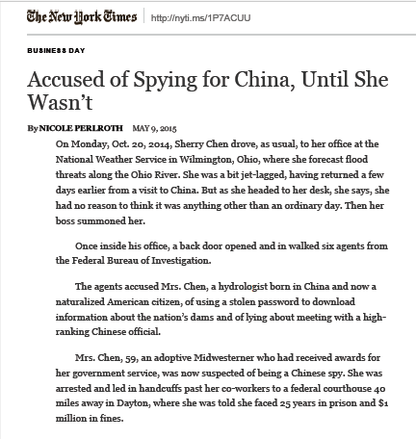
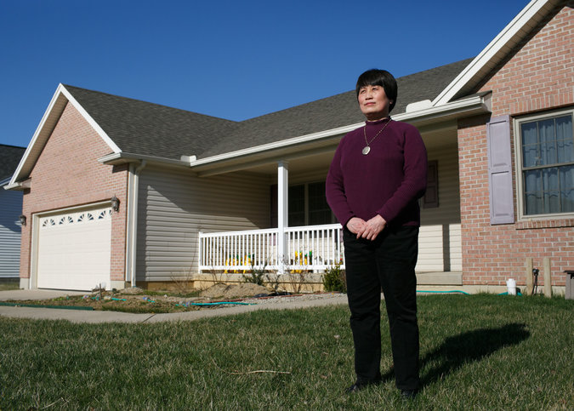
中国出生的美国水力学家被指为中国间谍

Slide 50
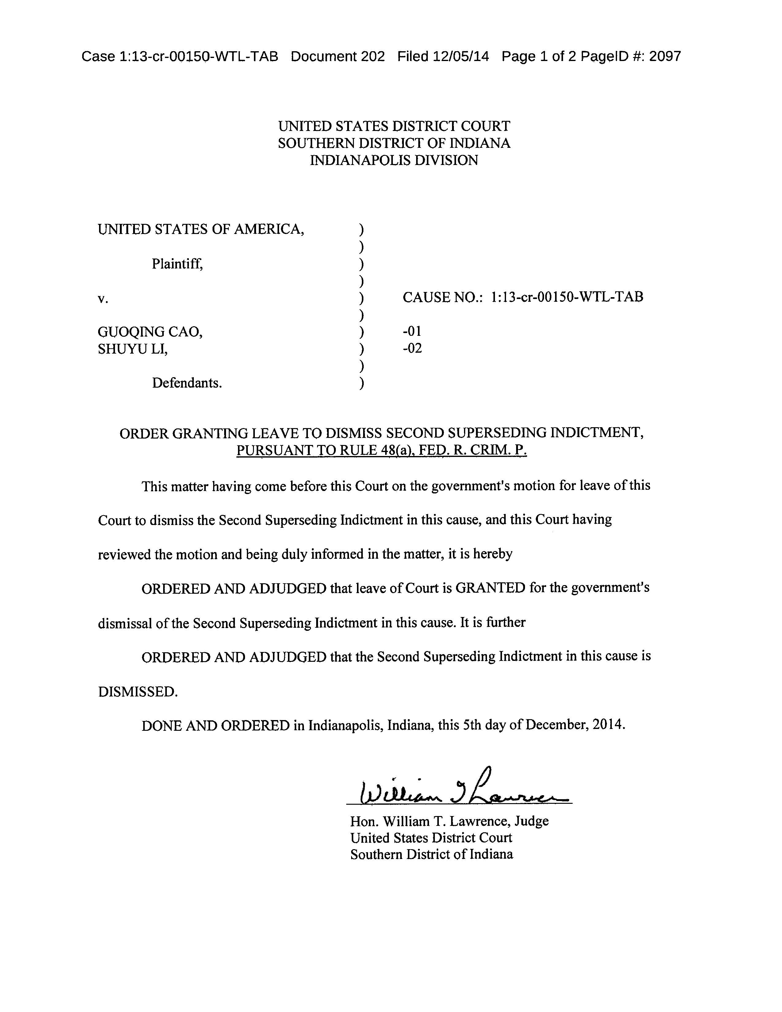
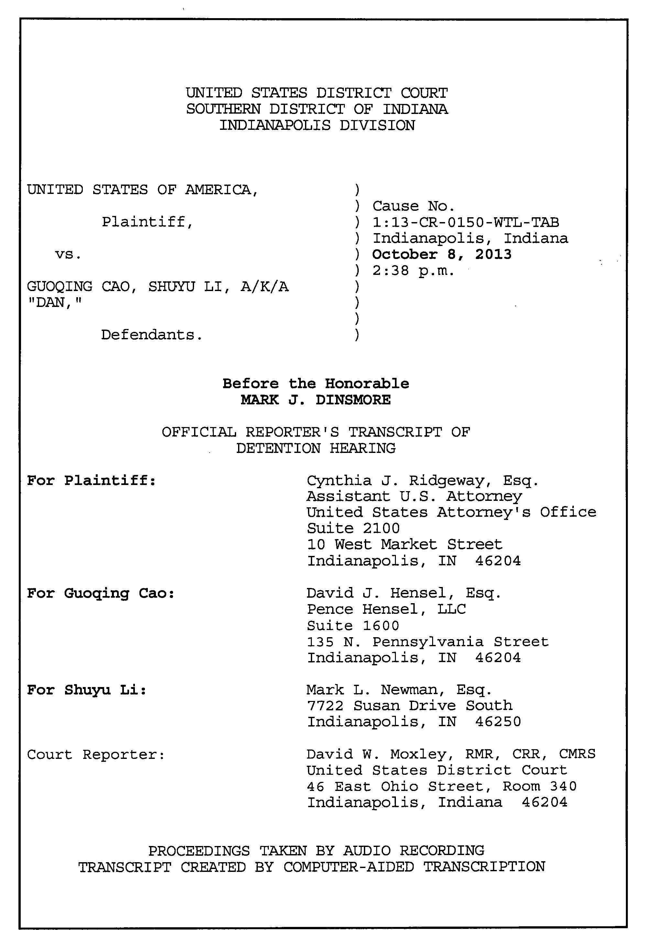
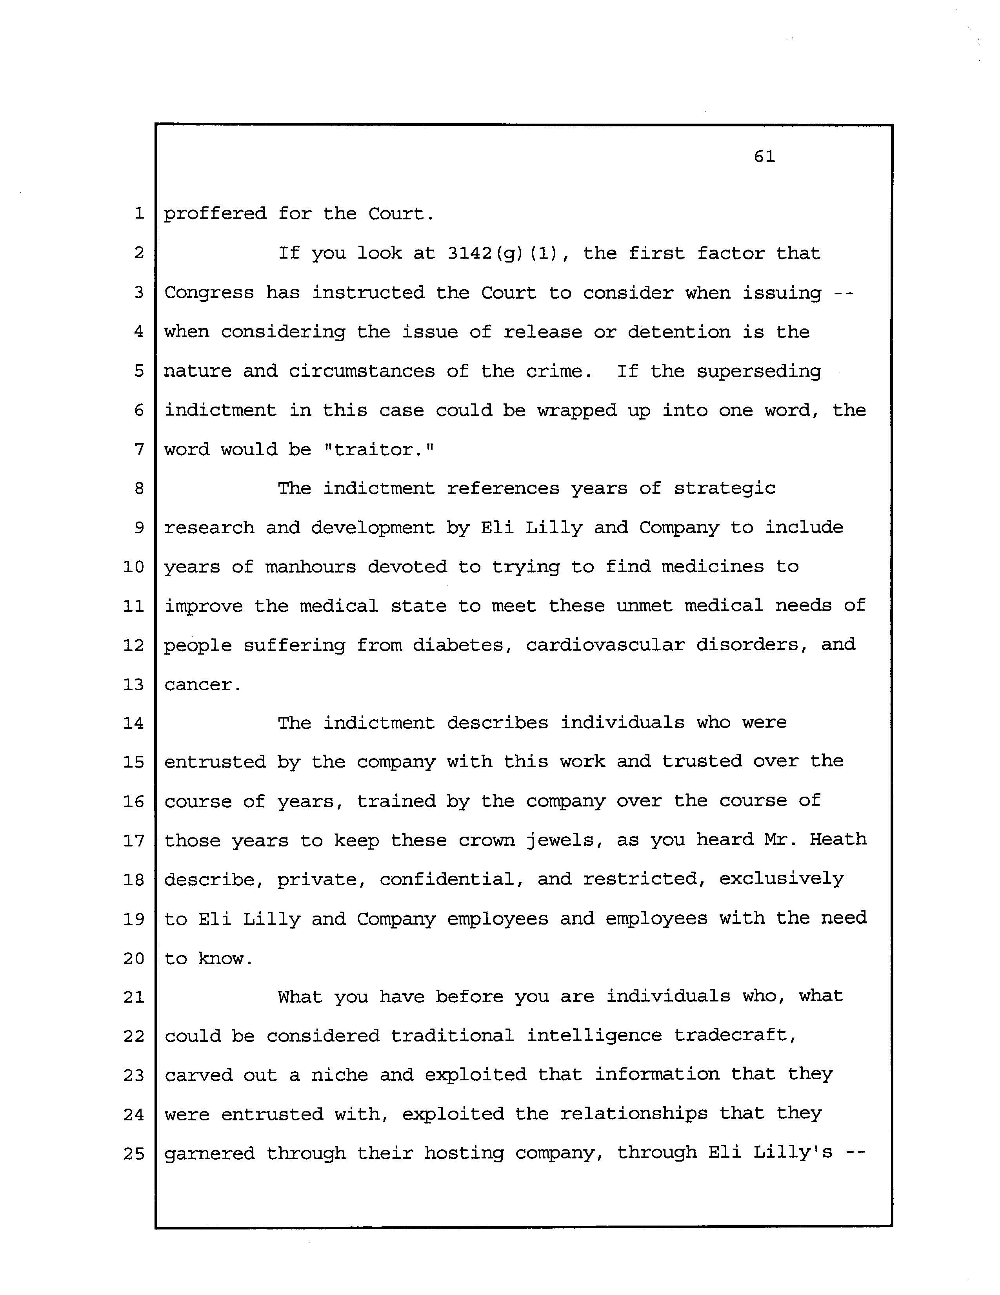
国会对法庭的干扰和施压

Slide 51
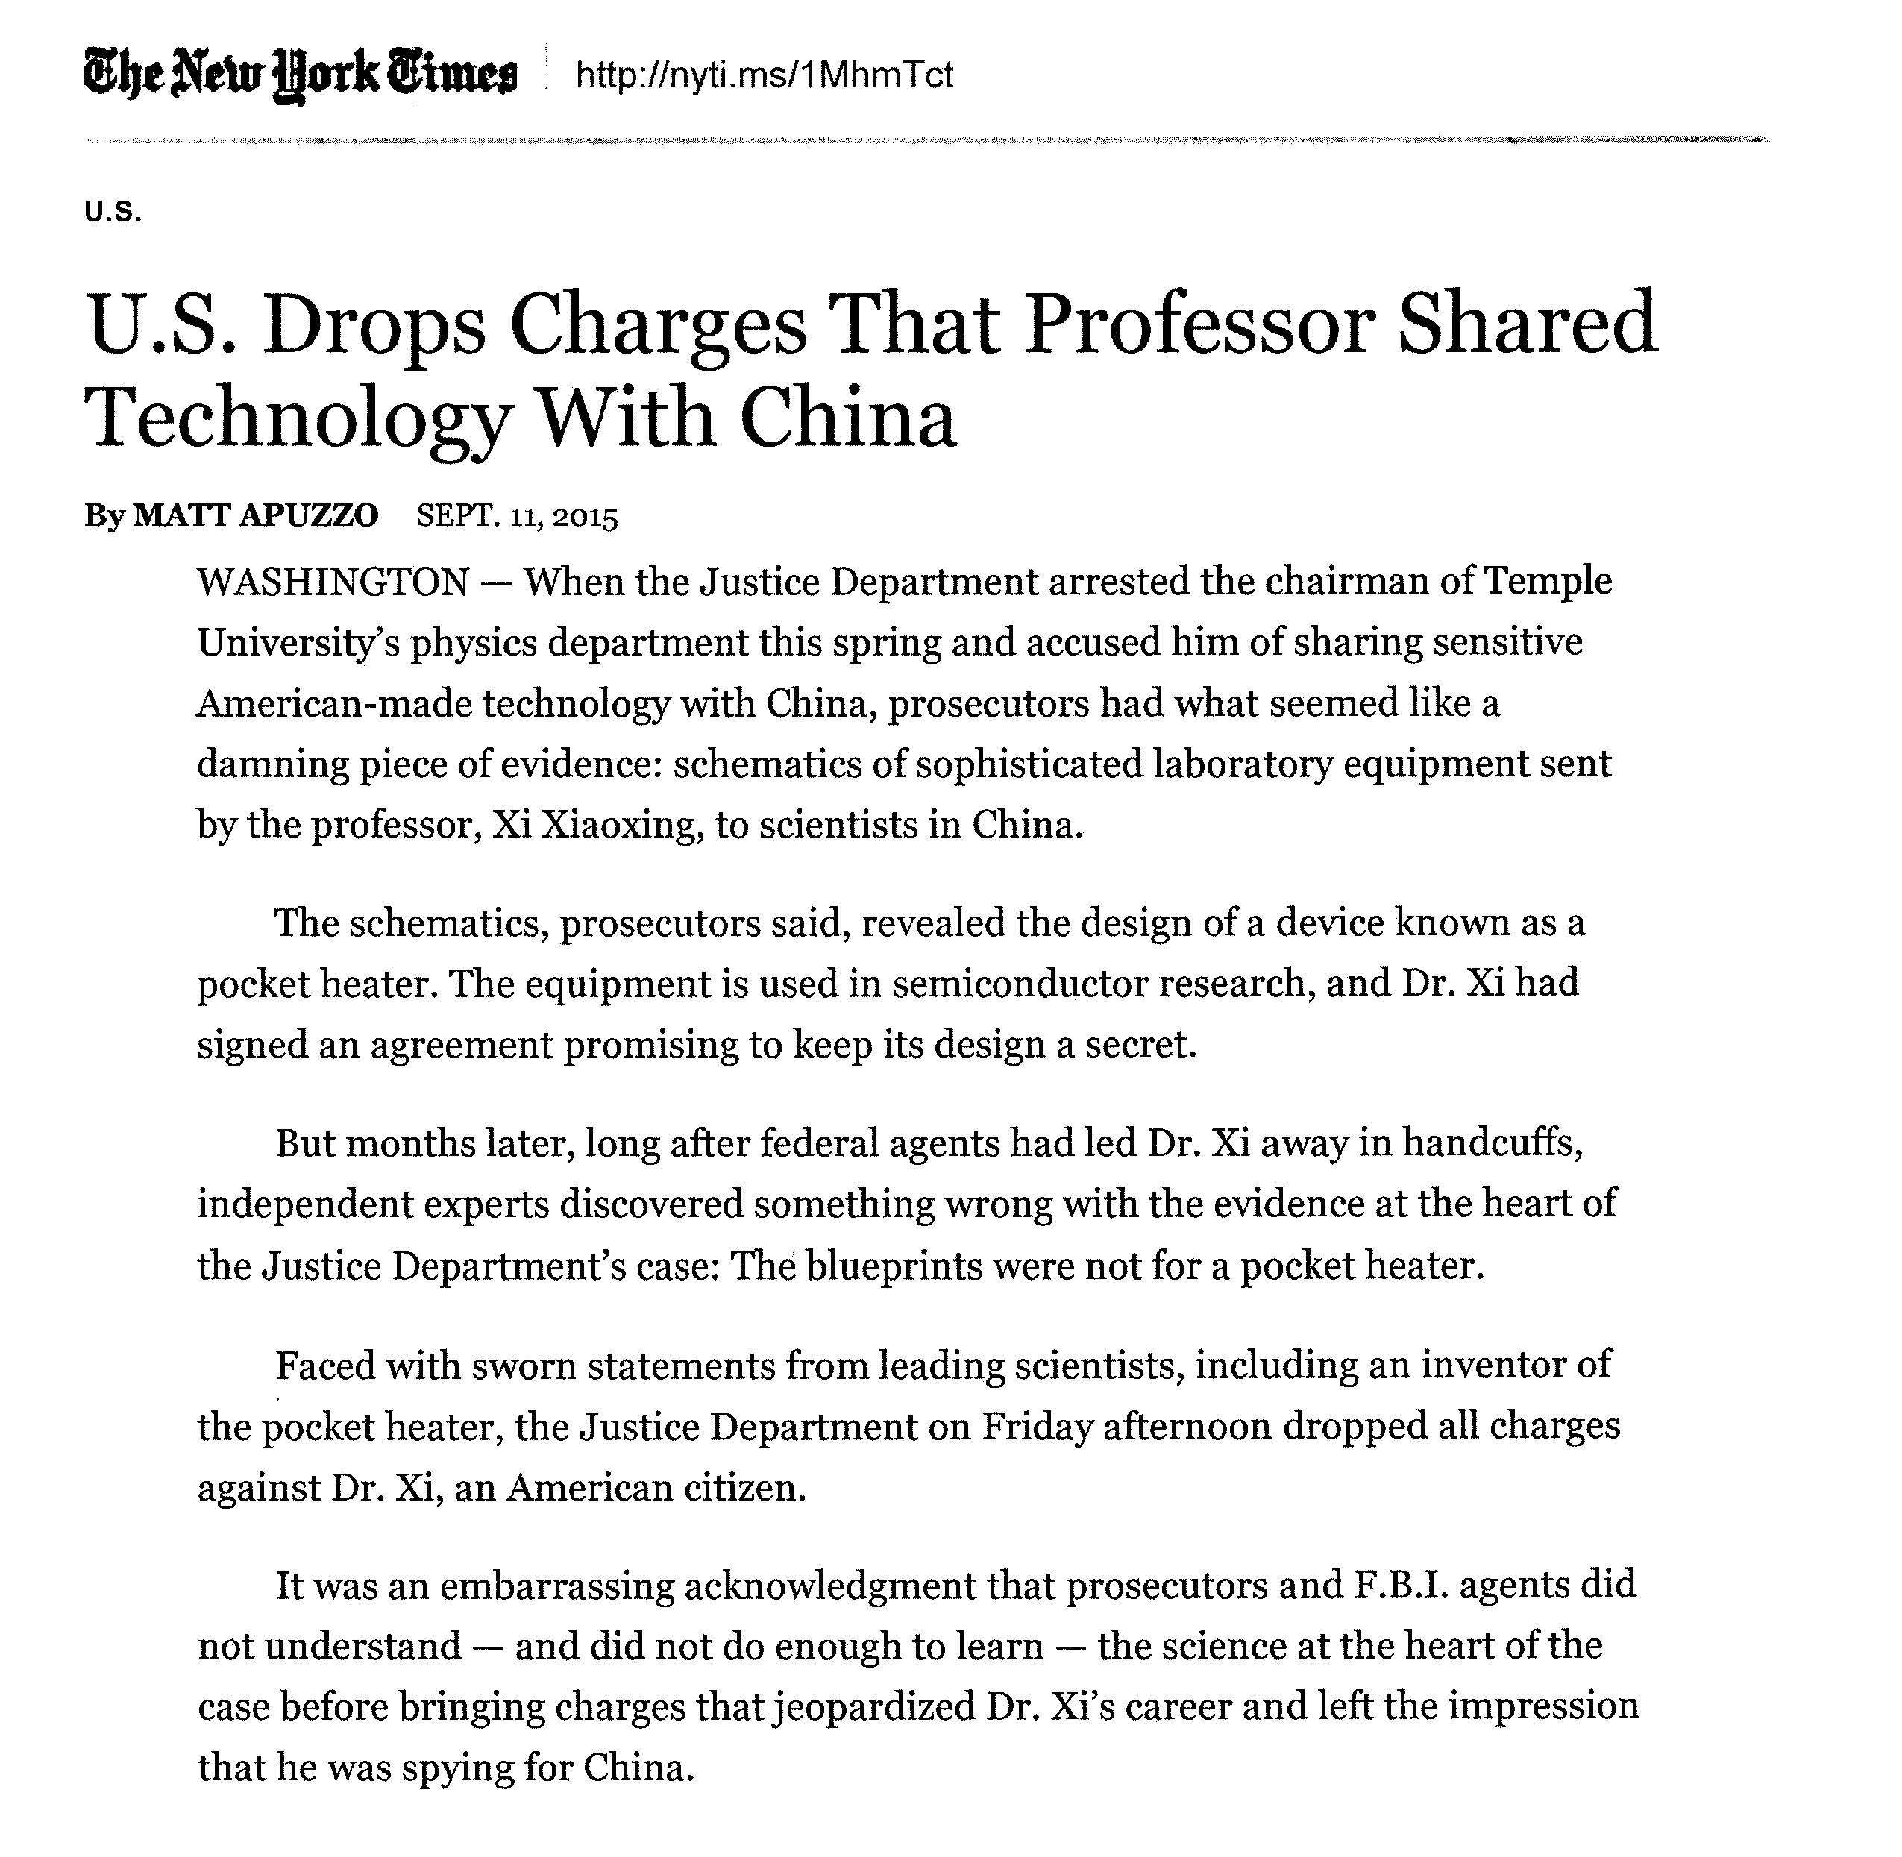
美国撤销对于天普大学教授与中国共享技术的指控
2015年9月11日

Slide 52
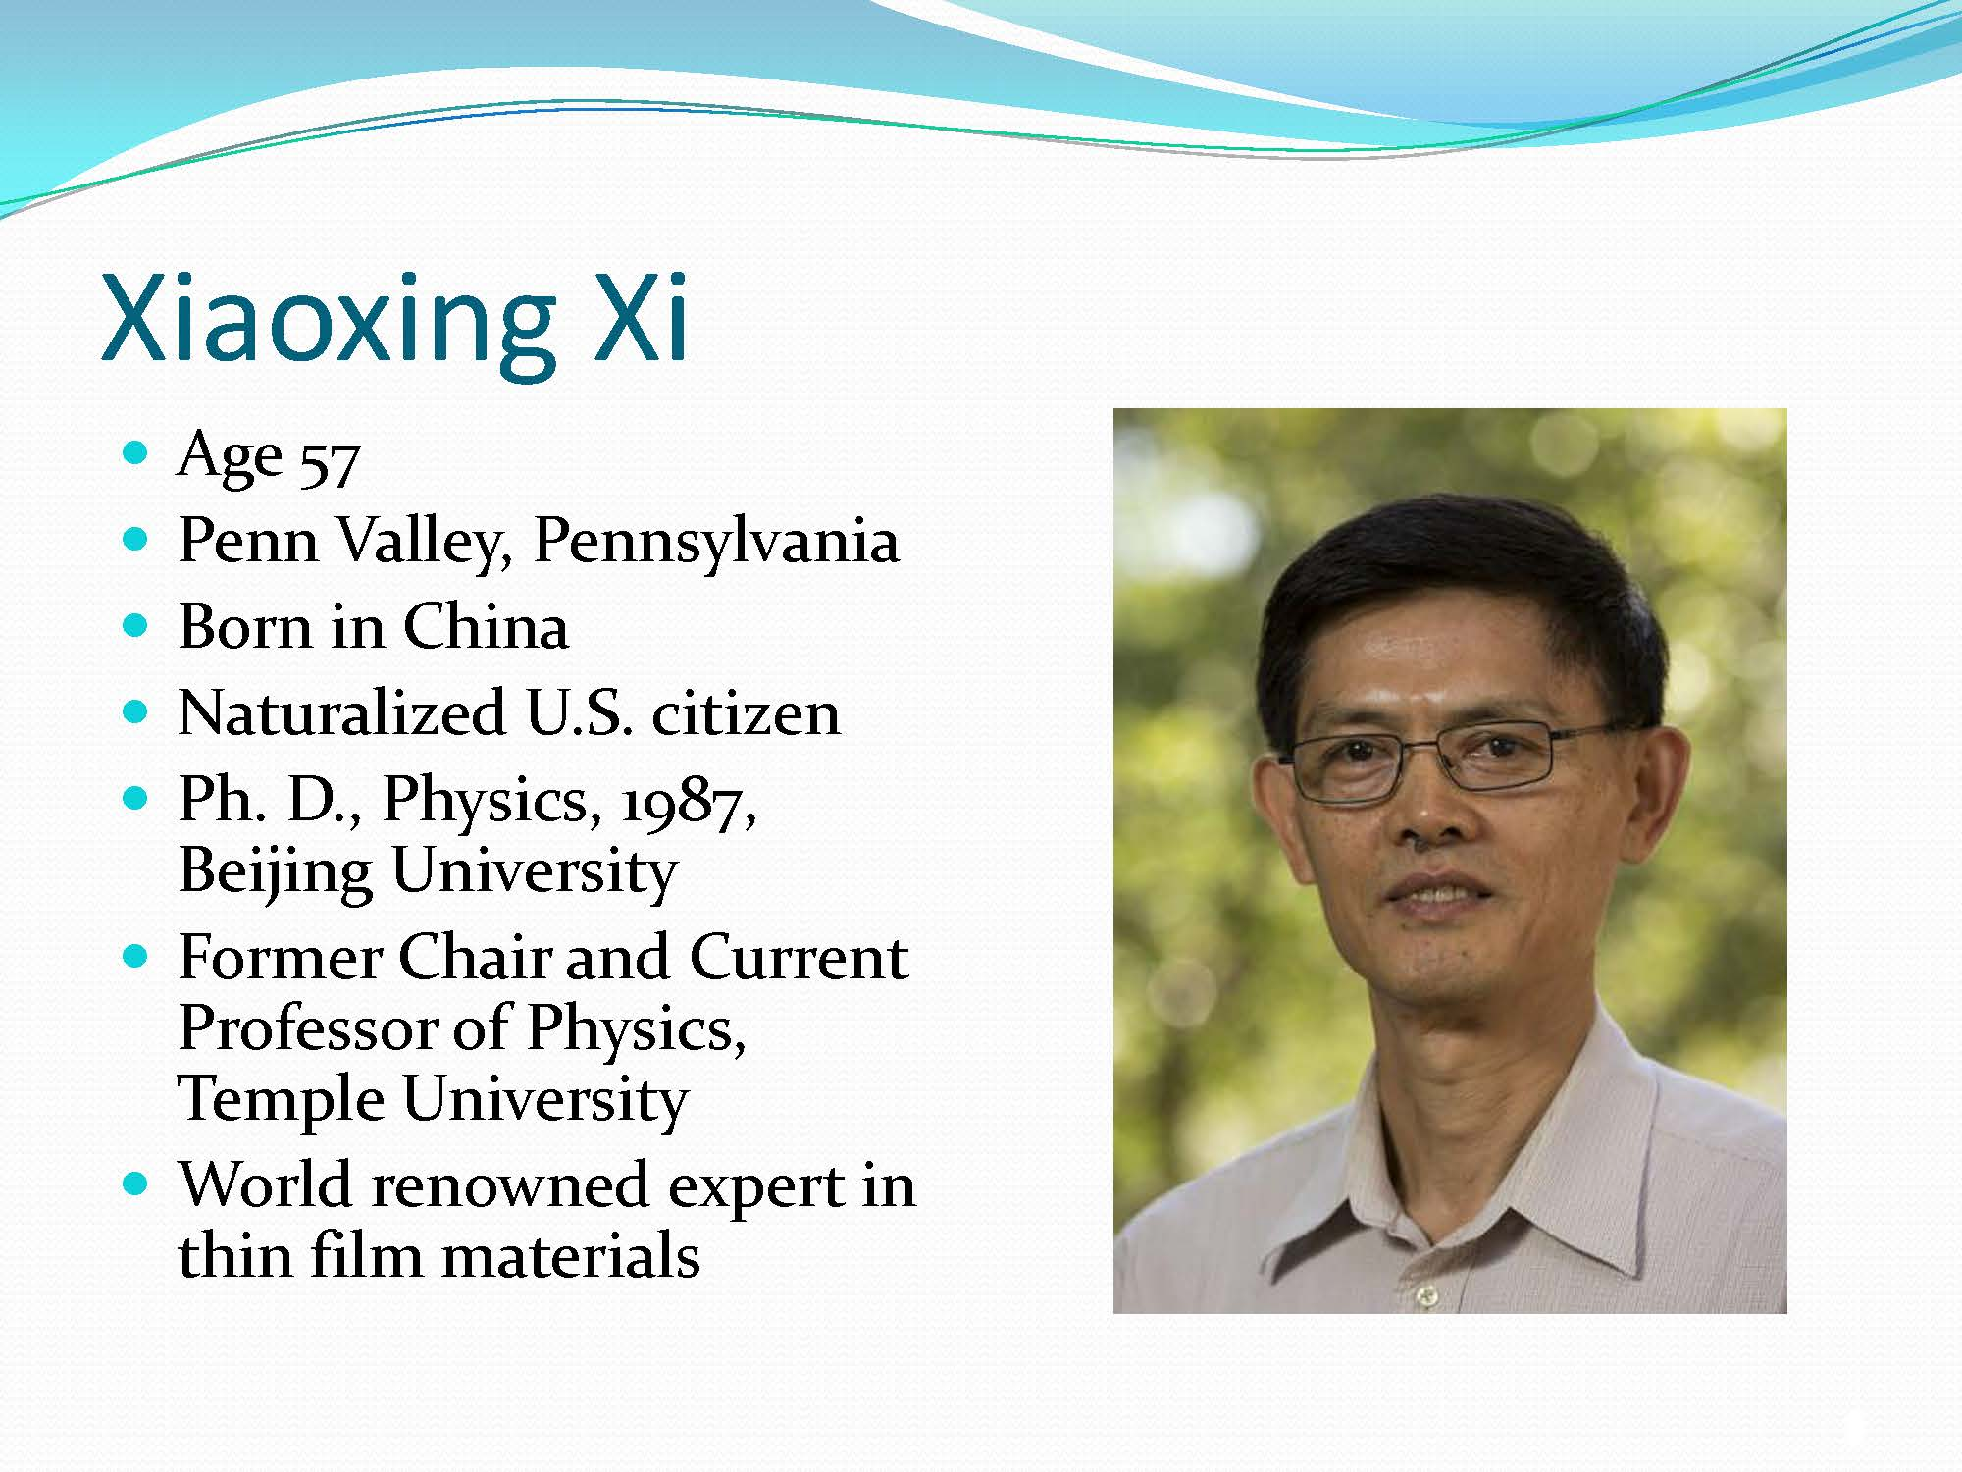

Slide 53
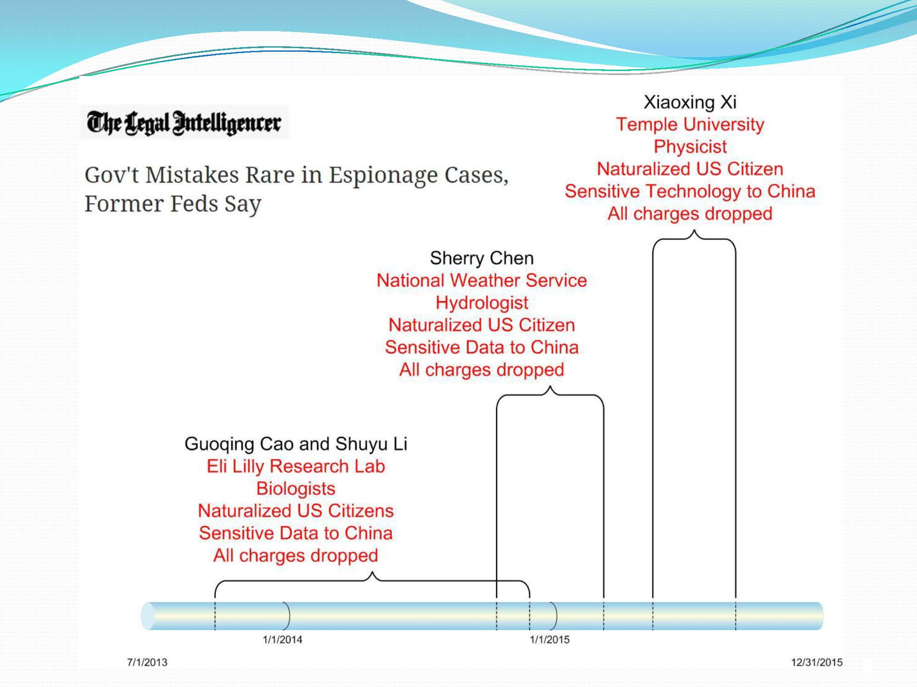

Slide 54
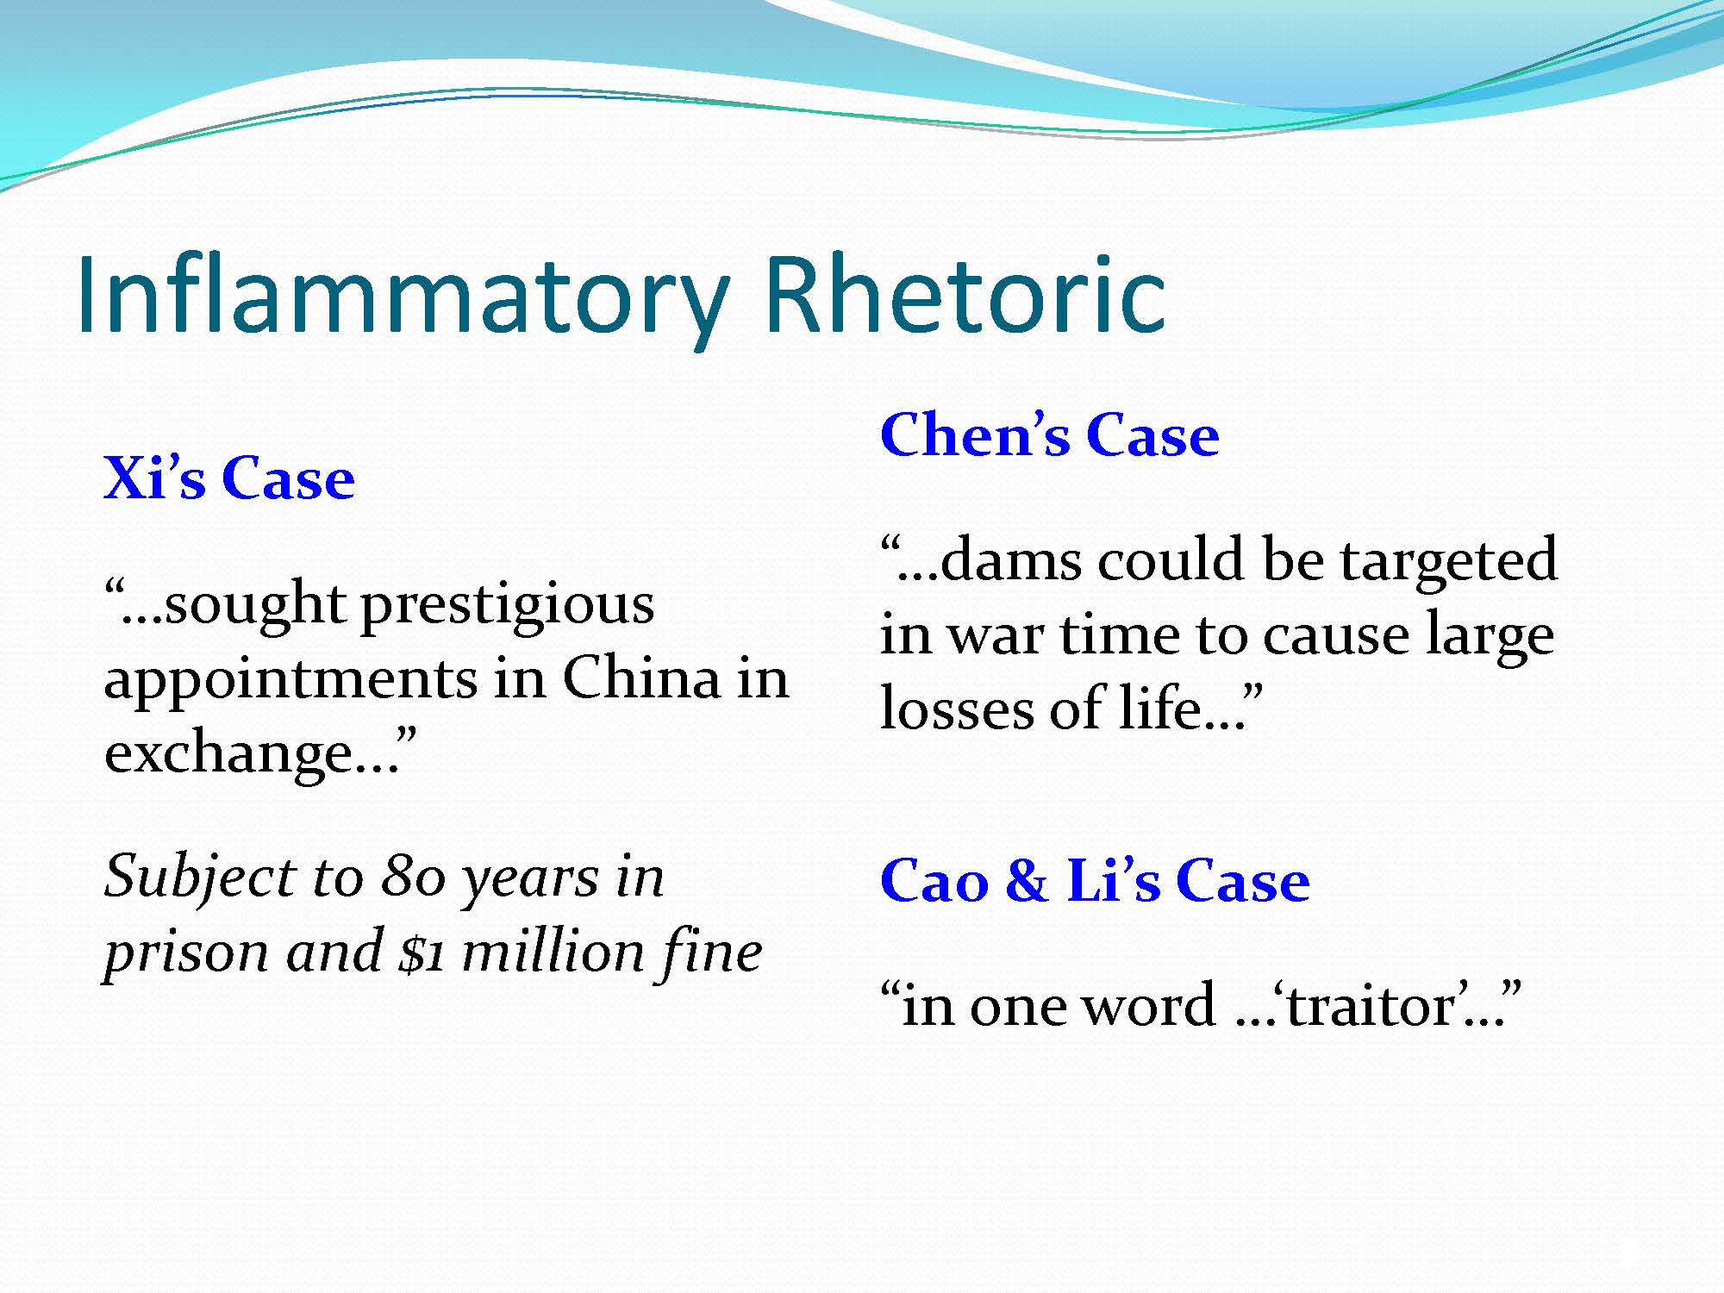

Slide 55
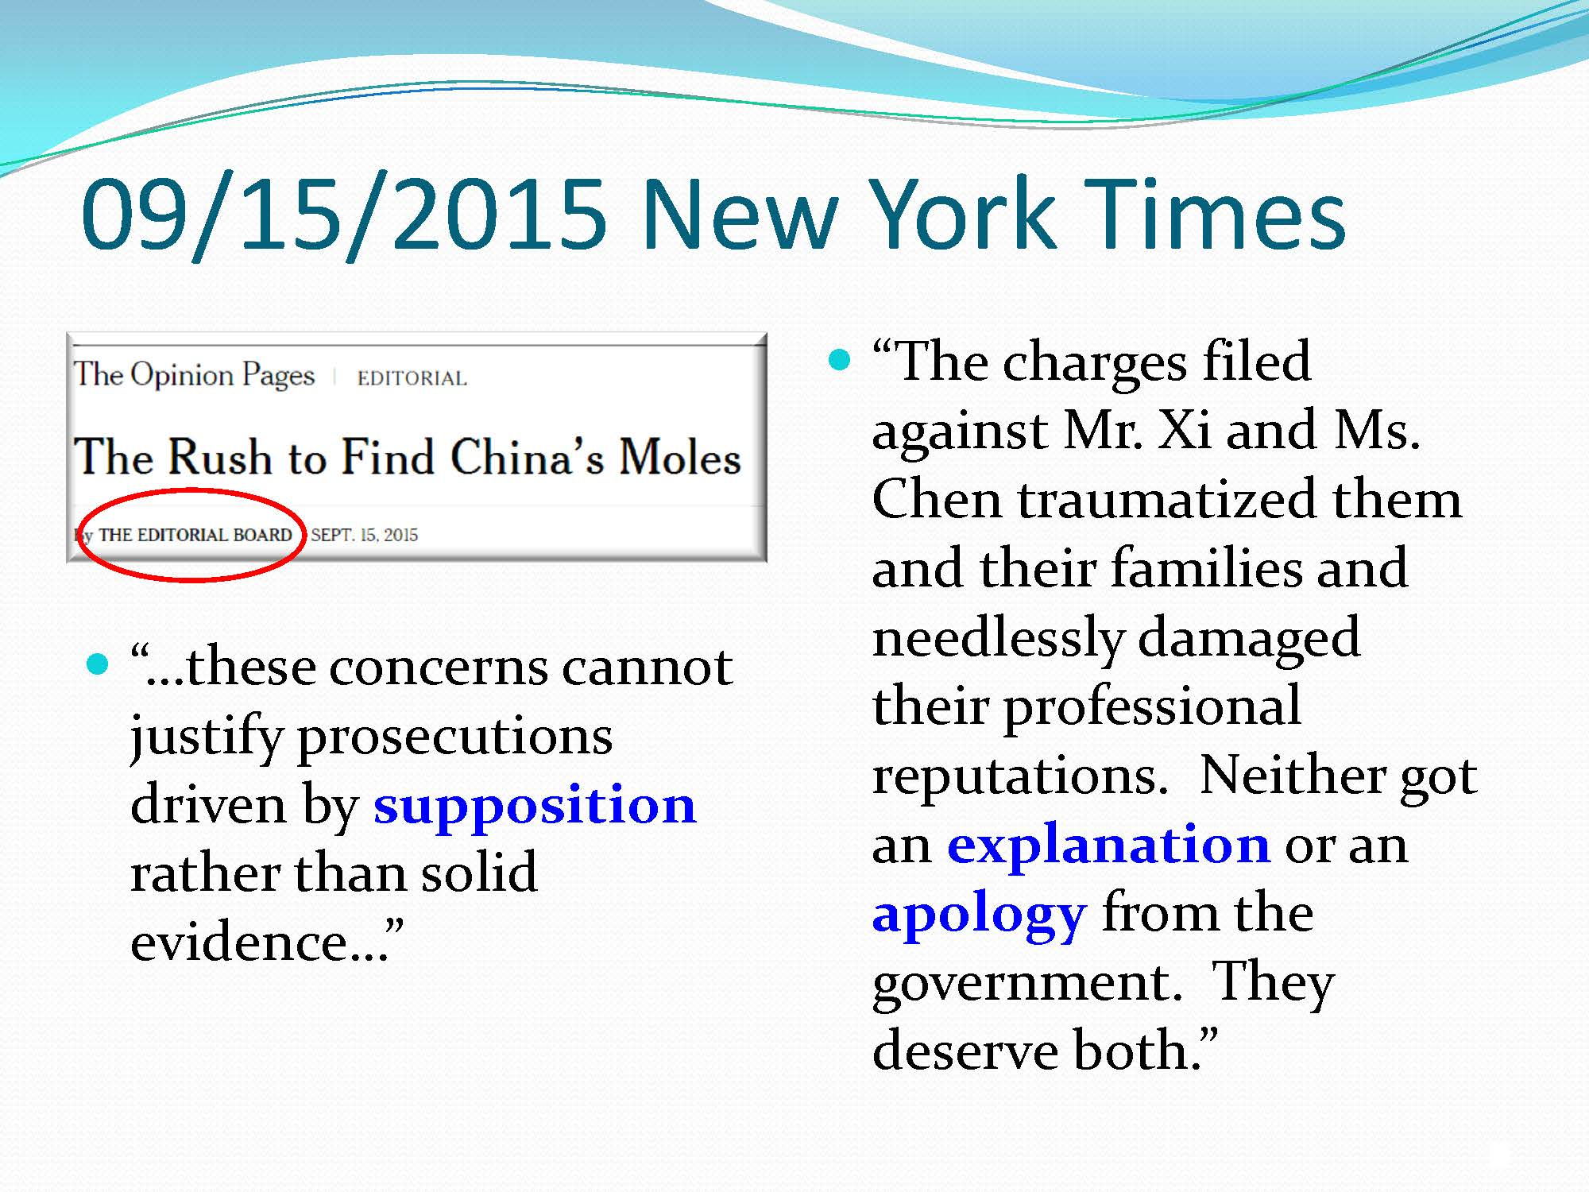

Slide 56
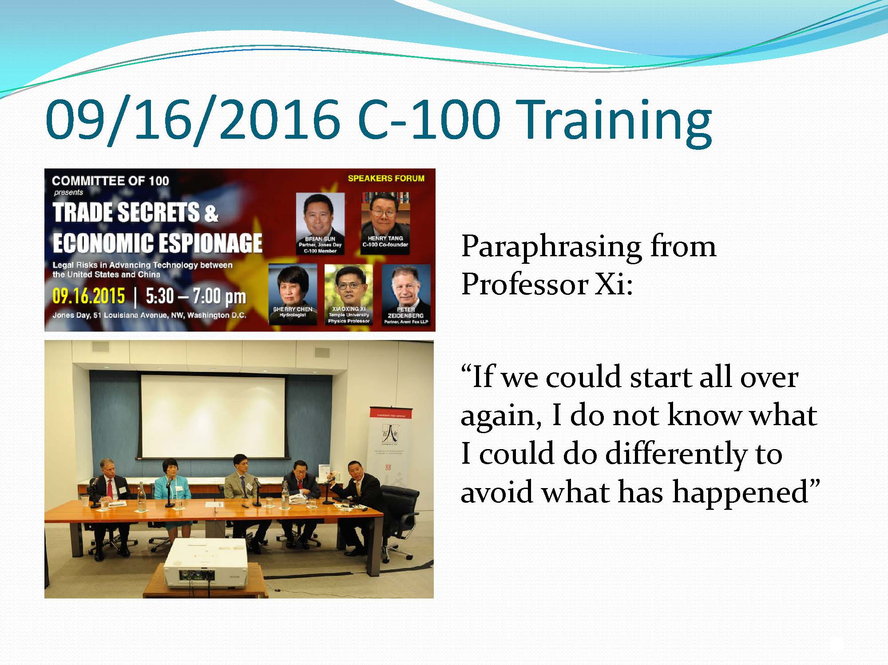

Slide 57
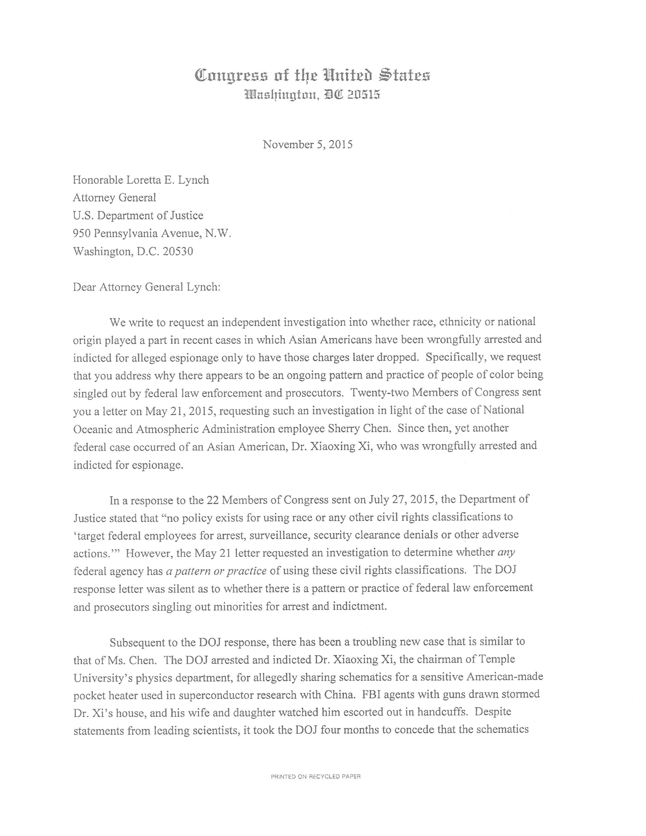


Slide 58



Slide 59

中国教授和6名被告被控为中国进行经济间谍和窃取活动
2015年5月19日

Slide 60

Criminal Prosecutions
刑事检控
中国以窃取国家机密为由羁押美国地质学家
一位中国出生的美国地质学家因在中国窃取国家机密被判处八年监禁
美国大使馆表示“失望”，并呼吁立即将其释放

Slide 61
Turning the Tables: PRC State Secrets Prosecution
局势转变：中国国家机密检诉
Xue Feng , a trained geologist and naturalized American citizen, born in the PRC, convicted in 2010 of violating China's "state secrets" laws after obtaining an oil industry database for his employer, a Colorado-based consulting company, IHS energy.
Xue insisted that the information in question was classified as "state secrets" only after he and IHS purchased the database.
China's state secrets laws are extremely vague and subject to broad interpretation.
Finally released by PRC authorities earlier this year after seven and a half years in custody.
薛峰，一个训练有素的地质学家和归化的美国公民，出生于中国，2010年因为其雇主、设立于科罗拉多州的咨询公司IHS能源，获取一个石油行业的数据库，被以触犯“国家机密”法定罪。
薛坚称在其和IHS购买该数据库后，有关资料才被列为“国家机密”
中国的国家机密法非常模糊，适用于广泛的解释
经过七年半的羁押后，终于在今年年初获中国当局释放

Slide 62
Unique Challenges and Risks
特有的挑战和风险
Chinese Americans often work in key science, technology, engineering and mathematics (STEM) fields
  Often deeply involved with valuable, sensitive technical or business information, both in industry and in government
  Often only vaguely aware of applicable U.S. laws
U.S. official reports state that Chinese government and some Chinese companies do seek illicit sources of such valuable information
  Numerous successful federal prosecutions of ethnic Chinese working in U.S., including both guilty pleas and convictions after trial
For these reasons, U.S. government (and some U.S. employers) may become skeptical or even suspicious
  Constant added hazards of “racial profiling,” bias, and misunderstanding of otherwise innocent conduct
美籍华人经常在关键的科学、技术、工程和数学（STEM）领域工作
  经常深入接触对于行业和政府均为宝贵而敏感的技术或商业信息
  通常仅对适用的美国法律有模糊认识
美国官方报告认为，中国政府和一些中国公司寻找以上宝贵信息的非法来源
大量对于在美工作华人的成功联邦检诉，包括认罪和审判后的定罪
由于这些原因，美国政府（和一些美国雇主）可能变得多疑
  一直将“种族定性”、偏见和误解的危险加在无辜的行为上

Slide 63
Take-Away Guidance
重点指引
Understand and comply with all applicable U.S. laws
  Espionage laws
  Export control laws
  Computer crime laws
Understand and comply with applicable employer or client non-disclosure agreements (NDAs), IP protection policies and rules
Understand potential use as “evidence” of whatever is sent or taken to China, whether as employee or personally
  Emails, text messages, faxes
  Smart phones, tablets, laptops, flash drives, etc.
Understand that normal 4th Amendment protection against “unreasonable search and seizure” does not apply to border searches of luggage or carry-on items
  Any electronic devices or storage media
  Any papers and documents
  Any travelers, whether outbound or inbound
  Any nationality travelers, including U.S. citizens and non-citizens
了解并遵守所有适用的美国法律
  间谍法
  出口管制法
  计算机犯罪法律
了解并遵守适用的雇主或客户保密协议（NDA），知识产权保护政策和规则
理解无论是作为雇员或个人任何送往或带到中国的物品可能作为 “证据”的潜在可能
  电子邮件、短信、传真
  智能手机、平板电脑、笔记本电脑、闪存驱动器等
了解正常的宪法第四修正案对于“不合理的搜查和扣押”的保护不适用于对行李或随身携带物品的边境检查
  任何电子设备或存储介质
  任何论文和文件
  所有旅客，无论是出境还是入境
  任何国籍的旅客，包括美国公民和非公民

Slide 64
Take-Away Guidance
重点指引
Beware of potential for becoming ensnared in illegal schemes (or what could appear as illegal schemes)
  Chinese efforts to obtain U.S. technology illicitly
    “Private” efforts by individuals to make illicit profits
    “Official” efforts by Chinese agents to benefit Chinese military
  U.S. efforts to “sting” those aiding such Chinese efforts
  Company efforts to protect internal corporate security
  Over-zealous investigators or security personnel who already have preconceived notions about “Chinese threat” or who engage in “racial profiling” against ethnic Chinese
If one becomes aware of a potential scheme or investigation, immediately consult personal counsel for independent legal advice
  Company counsel is NOT “personal counsel” or independent
  INTENTIONAL MISCONDUCT WILL LIKELY BE INVESTIGATED AND PROSECUTED TO MAXIMUM EXTENT OF APPLICABLE LAW
谨防有可能成为圈套的非法方案（或是看起来非法的计划）
  中国非法获取美国技术的行动
    “私人”非法牟利的行动
    “官方”使中国军队获益的中国间谍的行动
  美国对协助此类中国行动的人员“设陷阱”行动
  公司保障企业内部安全的行动
  过分热切的调查者或已经有关于“中国威胁论”或对华裔“种族定性”等先入为主观念的安保人员
如果意识到潜在的计划或调查，应立即咨询私人律师获取独立法律意见
  公司律师不是“私人律师”或独立顾问
  故意不当行为可能会被查处，并适用法律所允许的最大限度惩处

Slide 65
Take-Away Guidance
重点指引
Grave risks for such legal violations:
  Fines
  Imprisonment
  Loss of reputation and job (including permanent record of previous criminal activity)
  Civil litigation and potential exposure for further damages
  Jeopardy to U.S. visa status
  Jeopardy to naturalization process toward U.S. citizenship
  Collateral damage to family members, friends
  Collateral damage to companies, investors, co-workers
Best course is to be fully aware of one’s legal responsibilities under U.S. law and to avoid conduct that would create potential violation risks or appearance of such risks!
此类违法行为的严重风险：
  罚款
  监禁
  声誉和工作损失（包括永久的犯罪活动记录）
  民事诉讼和更大损害的潜在风险
  危害到美国的签证状态
  危害归化入籍过程
  对家人、朋友的连带损害
  对公司、投资者、同事的连带损害
最好的办法是要充分认识到个人依照美国法律规定应承担的法律责任，避免造成潜在违规的风险或看似有类似风险的行为!

Slide 66
Take-Away Guidance
重点指引
Committee of 100
257 Park Avenue South, 19th Fl.
New York, NY 10010
百人会
257号公园大道南，19层
纽约市，纽约州 邮编： 10010
电话 Phone: 212-371-6565
传真 Fax: 212-371-9009
www.committee100.org
THESE MATERIALS AND ANY PRESENTATION BASED THEREON ARE SOLELY FOR GENERAL EDUCATIONAL PURPOSES TO PROMOTE PUBLIC DISCUSSION AND UNDERSTANDING. THEY ARE NOT INTENDED TO BE, AND SHOULD NOT BE TAKEN AS, LEGAL ADVICE. ANYONE WITH A SPECIFIC LEGAL QUESTION SHOULD RETAIN AND CONSULT QUALIFIED LEGAL COUNSEL.
以上材料和基于此的任何演示只可用作一般性教育目的，以促进公开的讨论和理解。它们不意图作为也不应该被视为法律咨询。任何人有具体法律问题应保留并咨询有资质的法律顾问。
© Committee of 100 2015. All rights retained.

